Slide 1
Parent Forum
Dealing with Anxiety

Slide 2
Dealing with Anxiety
We want to:
Give you information about the main triggers of anxiety for students
explain what we do in school to support students who suffer from anxiety
provide strategies for students to use to help reduce anxiety
give you some examples of how you can support your child to cope with anxiety
signpost you to further sources of advice and guidance.

Slide 3
What is the National Picture?
Wellbeing on most measures remains consistent
Anxiousness amongst pupils has ‘worsened’
Secondary-age boys reported better wellbeing
Rates of mental disorders and eating problems among young people remain at ‘elevated levels’
National and global changes - including increasing cost of living will likely have a ‘substantial impact’
Mental disorders amongst 17- to 19-year-olds have increased
The percentage of those reporting low happiness with their family and friends remains at elevated levels
Children and young people’s average happiness appear similar to previous years
Most secondary-age children and young people reported being motivated to learn, were managing to concentrate in class, felt safe at school, enjoyed being at school, and felt that they belonged at school
© The Key Support Services Limited

Slide 4
What can we are doing as a school?
ACT
Mental Health strategy
Mental health awareness week
Young Health champions
Tutor programme and PCs
School ethos
Teach social and emotional skills
Talk about mental health
Support children who are more at risk
Work with families
Support staff wellbeing
Spot potential signs and get support
© The Key Support Services Limited

Slide 5
Imagine …
UNDERSTAND
© The Key Support Services Limited

Slide 6
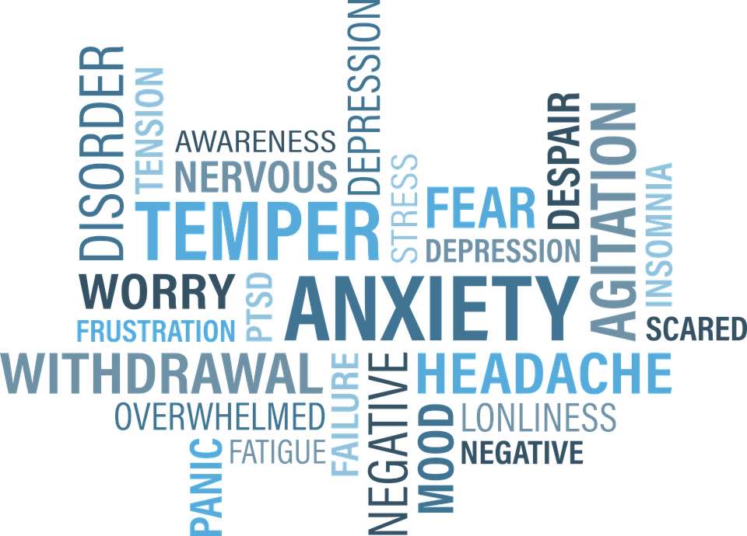

Slide 7
Triggers of Anxiety

Slide 9
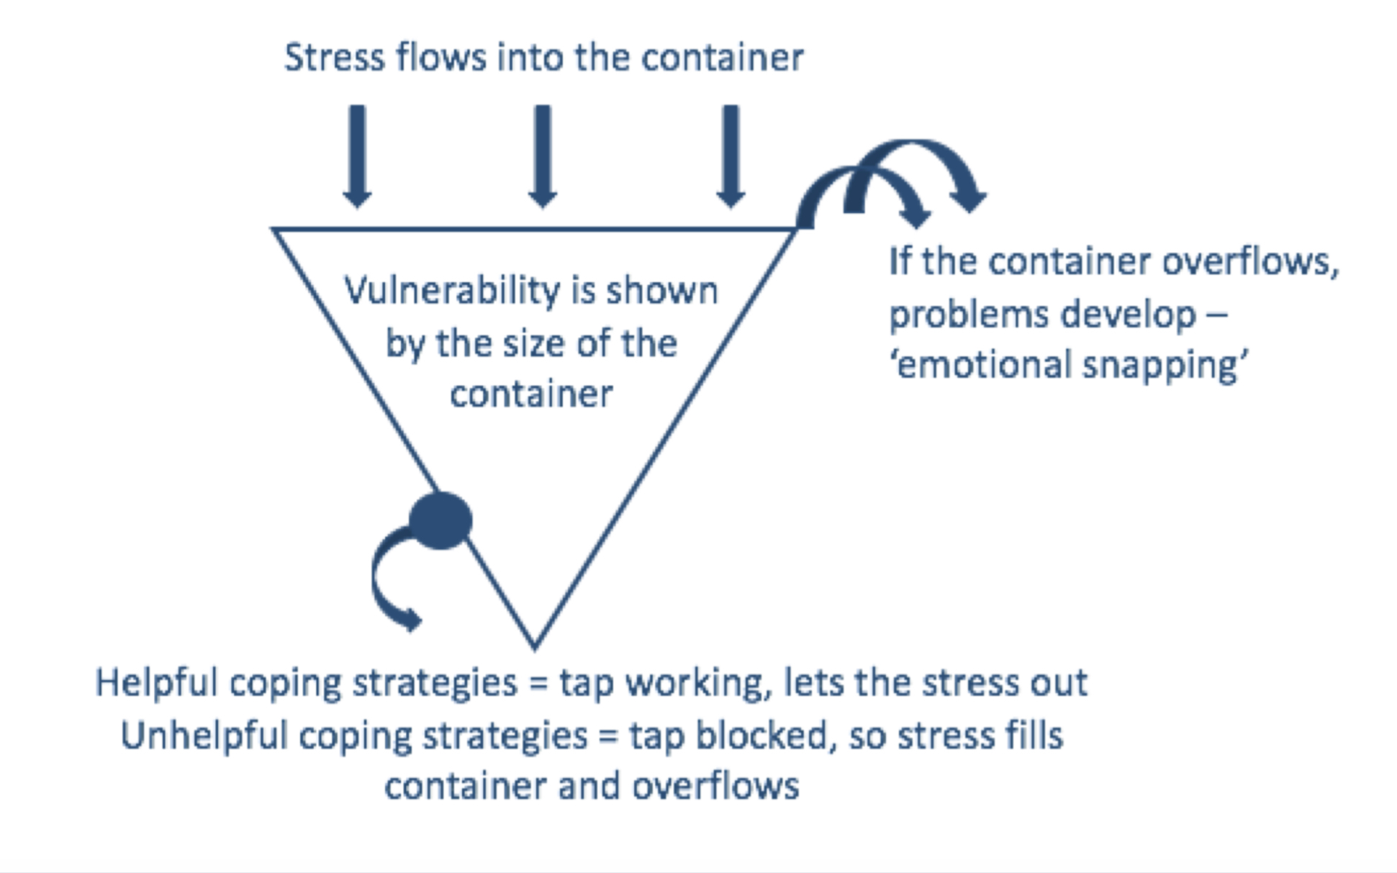
Stress Container

Slide 10
Signs that a child’s anxiety may be a problem
SPOT
Trying to avoid situations that make them anxious
Worrying a lot and not being able to stop
Seeking reassurance
Seeking reassurance
Aggression
Behaviour concerns
Disengagement with learning
Physical signs, like headaches or sweating
Difficulty eating
Panic attacks
© The Key Support Services Limited

Slide 11
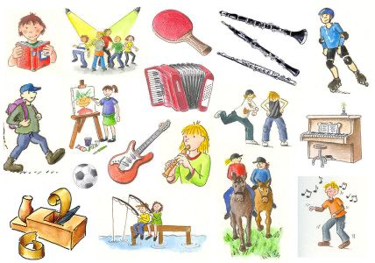
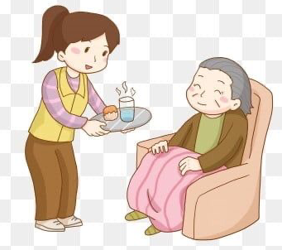
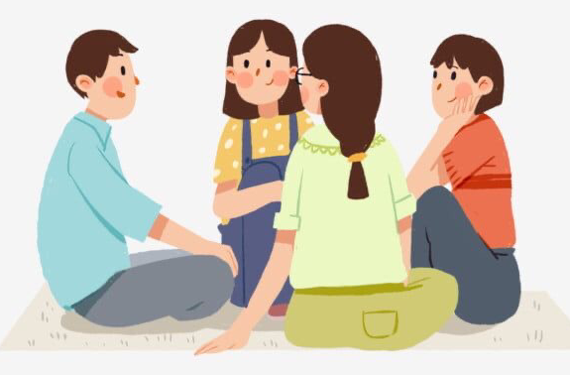
Get Active
Keep Learning
Give
Connect
Take Notice

Slide 12
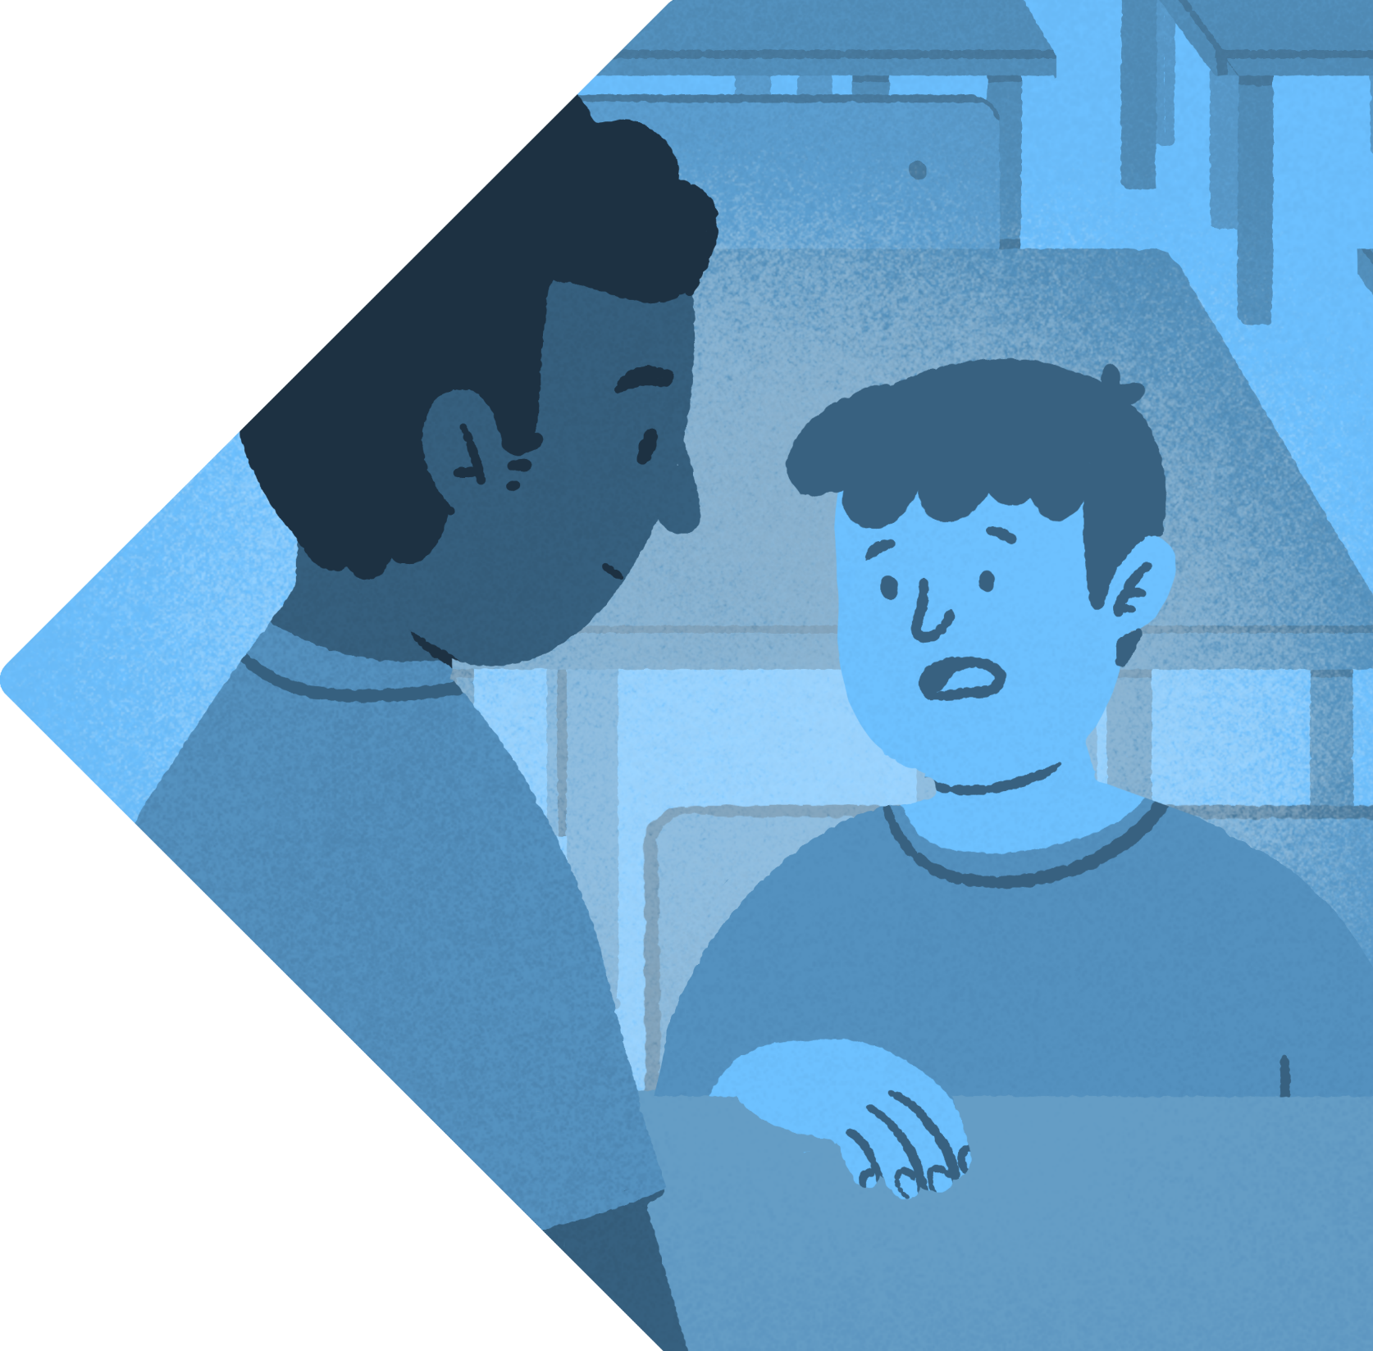
Why would a child
self-harm?
UNDERSTAND
As a coping mechanism
As a form of release
To punish themselves
To send a sign that they’re distressed
© The Key Support Services Limited

Slide 13
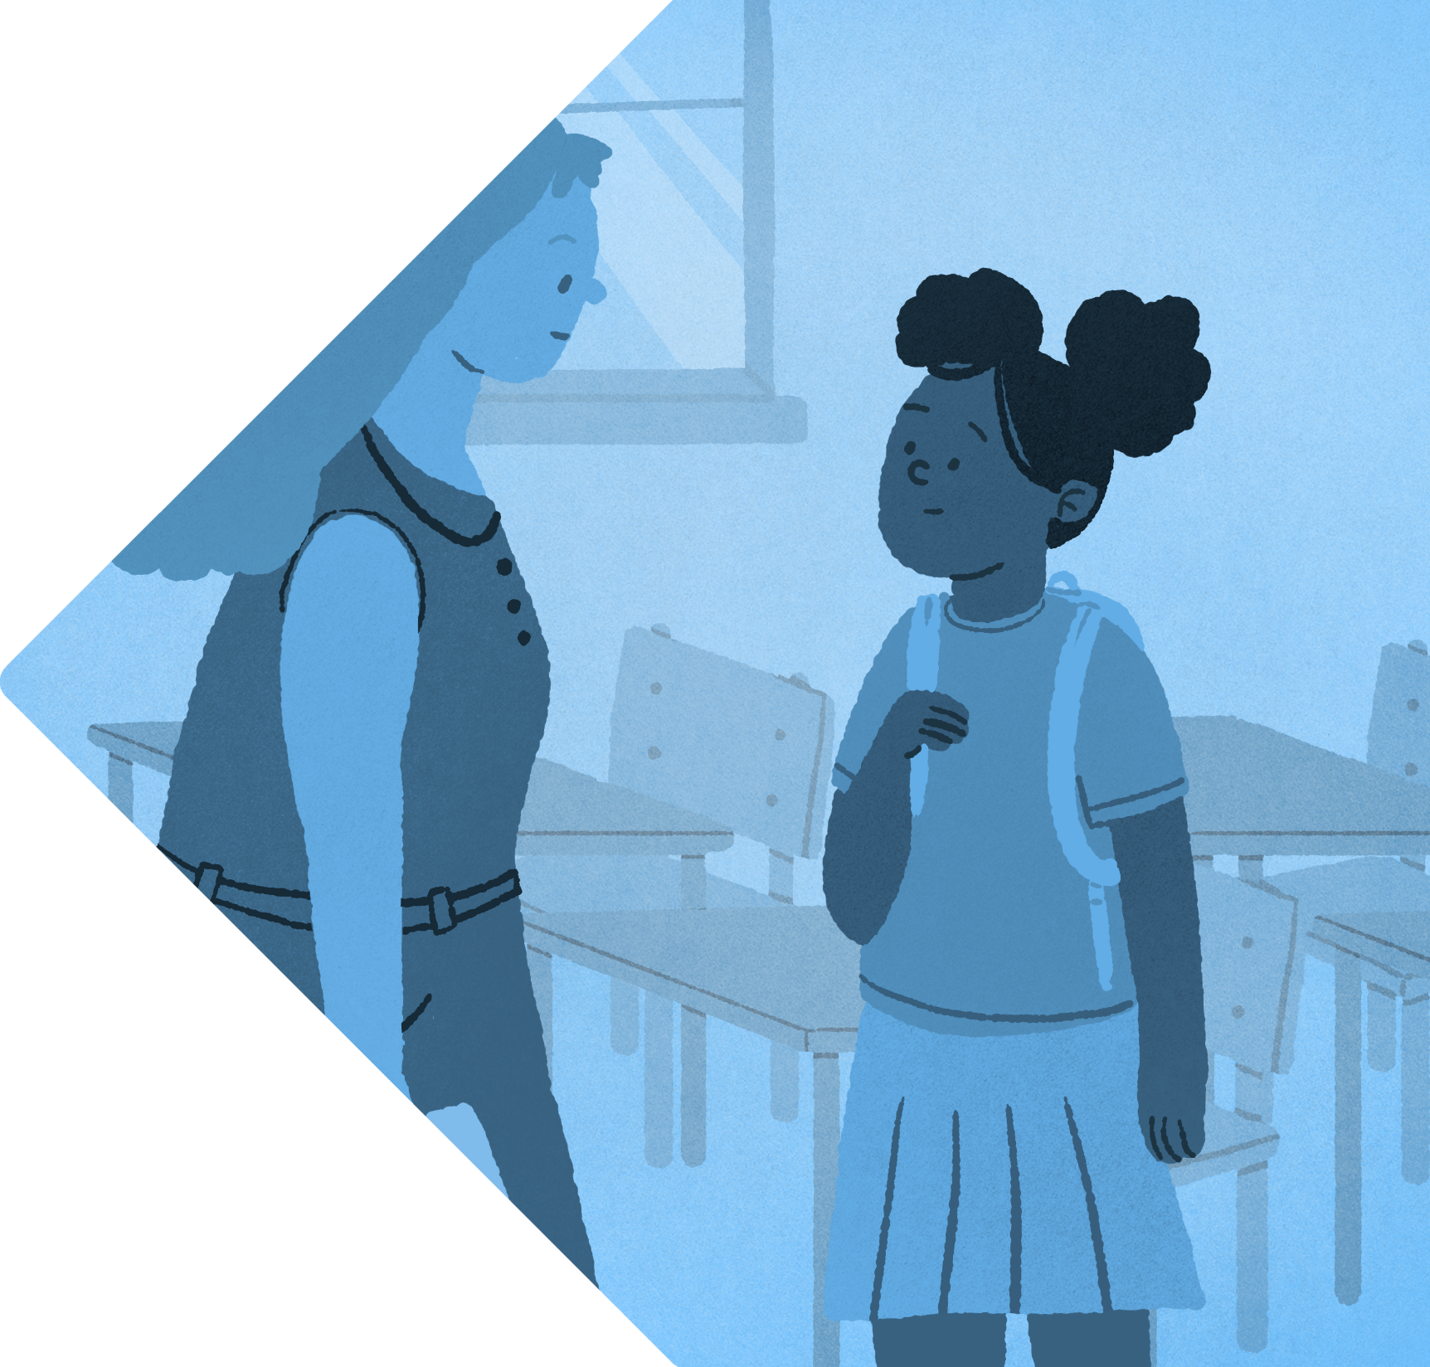
What puts a child more at risk?
UNDERSTAND
Traumatic experience
Bereavement
Alcohol or drug misuse
Having a
learning difficulty
© The Key Support Services Limited

Slide 14
What to say…
ACT
Listen and show concern
Help to find other ways to cope
Say something
Contact
“I noticed some scars on your arm the other day and felt worried for you”
“I wondered what’s going on for you at the moment because I noticed some marks on your arm”
“Can you tell me more about that?”
“I’m sorry to hear that”
“That sounds difficult”
“How do you feel before doing it? What could you do to let out your feelings in a different way?”
As soon as possible, contact the safeguarding team for support and next steps.
Take child to the GP
© The Key Support Services Limited

Slide 15
Seeking Support

Slide 17
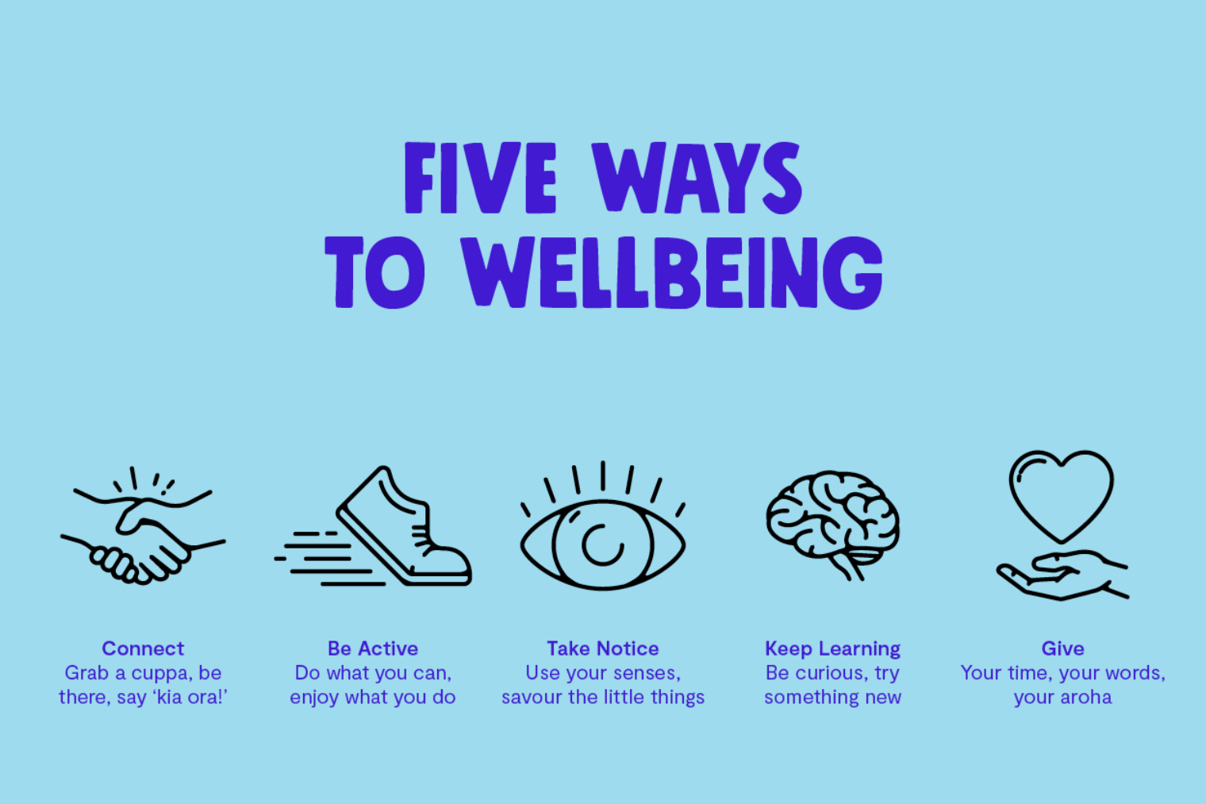

Slide 18
CONTACT US
Safeguarding@lgs.slough.sch.uk

Slide 19
