Slide 1

Parent Forum
Understanding Mental Health

Slide 2
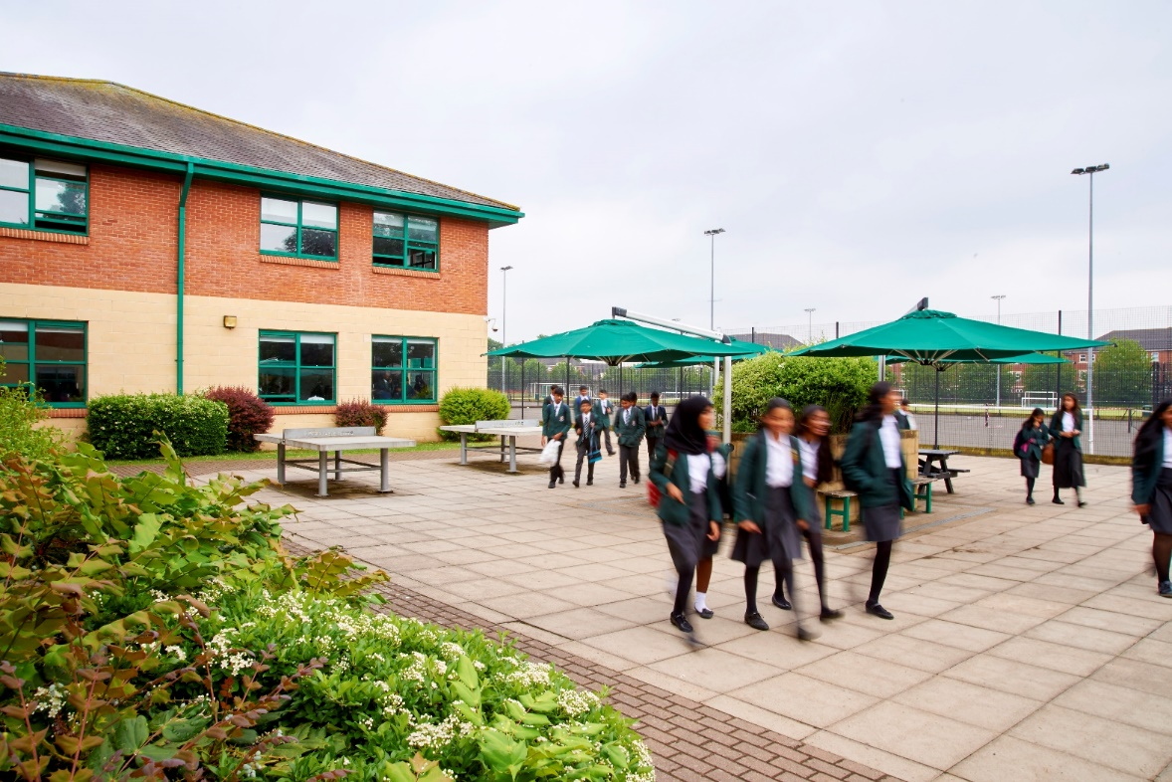
Understanding Mental Health
We want to:
support your understanding of what ‘mental health’ means;
update on the national picture regarding young people and their mental health;
provide an overview of what issues and trends we are seeing with students in school;
help you to support your child if you or they have concerns about their mental health;
signpost you to further sources of advice and guidance;
provide advice on how you can look after your own mental health.

Slide 3

Mental health: we all have mental health, just as we all have physical health.
Mental wellbeing: the ability to cope with the day-to-day stresses of life, work productively, interact positively with others and realise our own potential.
Poor mental health: when we are struggling with low mood, stress or anxiety. We all go through periods of experiencing poor mental health.

Slide 4

Mental health problems: when difficult experiences or feelings go on for a long time and affect our ability to enjoy and live our lives in the way we want
Common mental health problems: these include depression, anxiety, phobias and obsessive-compulsive disorder (OCD).
Severe mental health problems: These include conditions like schizophrenia and bipolar. They may require more complex and/or longterm treatments

Slide 5
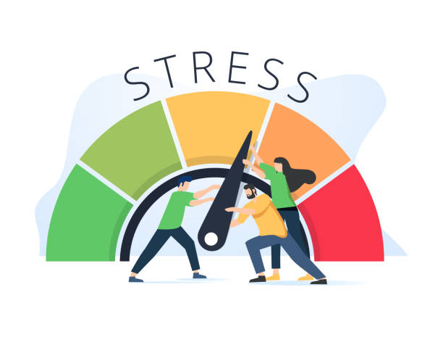
Work-related stress is defined by the Health and Safety Executive as the adverse reaction people have to excessive pressure or other types of demand placed on them at work
Burnout: refers to a collection of symptoms. You may feel exhausted, have little motivation for your job, feel irritable or anxious

Slide 6

National Picture
One in five children and young people in England aged eight to 25 had a probable mental disorder in 2023
20.3% of eight to 16-year-olds had a probable mental disorder in 2023. Among 17 to 19-year-olds, the proportion was 23.3%, while in 20 to 25-year-olds it was 21.7%
NHS Mental Health Director Claire Murdoch said: “Today’s report shows the continued unprecedented pressures faced by young people and reflects the increased demand for NHS children’s mental health services.’
© The Key Support Services Limited
Notes:
https://www.england.nhs.uk/2023/11/one-in-five-children-and-young-people-had-a-probable-mental-disorder-in-2023/#:~:text=The%20Mental%20Health%20of%20Children,%2Dolds%20it%20was%2021.7%25

Slide 7
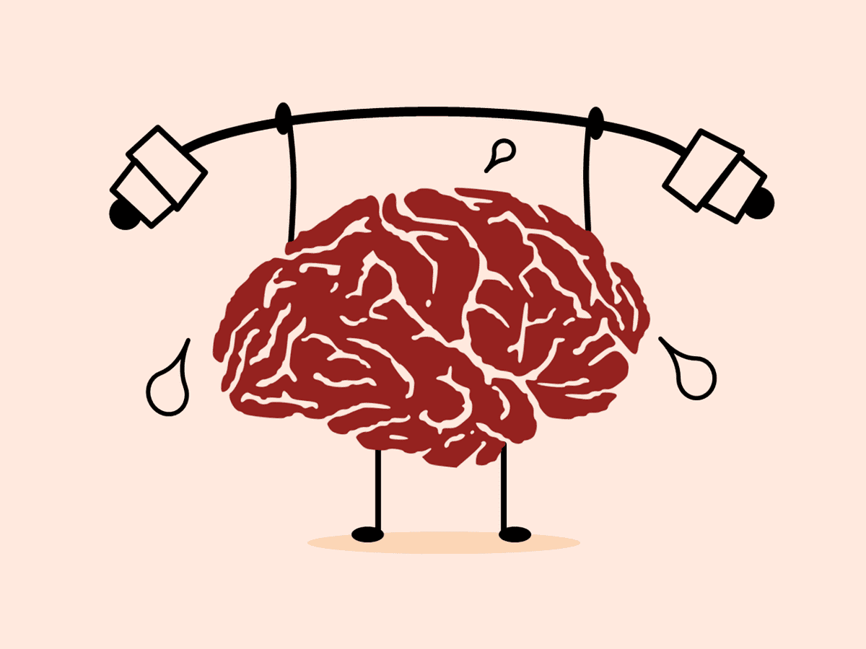
Preventative tips
Identify triggers
Take time for yourself
Be kind to yourself
Connect with friends
Celebrate small successes
Set boundaries
Get the basics right
Ask for help
Learn to say no

Slide 8

Suicide
Attempted suicide is a major health problem amongst young people. Young woman and girls make the highest number of suicide attempts between the ages of 15 and 19
It is estimated that 9% of 16-24 year olds have attempted suicide at some point in their life.
Suicide can be a result of a build up of stressors in someone who has limited protective and resilience factors.
Be alert to children expressing:
  Negative thoughts
  Changes in physical appearance
  Behaviour changes
It is ok to speak with your child should you be concerned
Contact GP or A&E and alert the school.

Slide 9
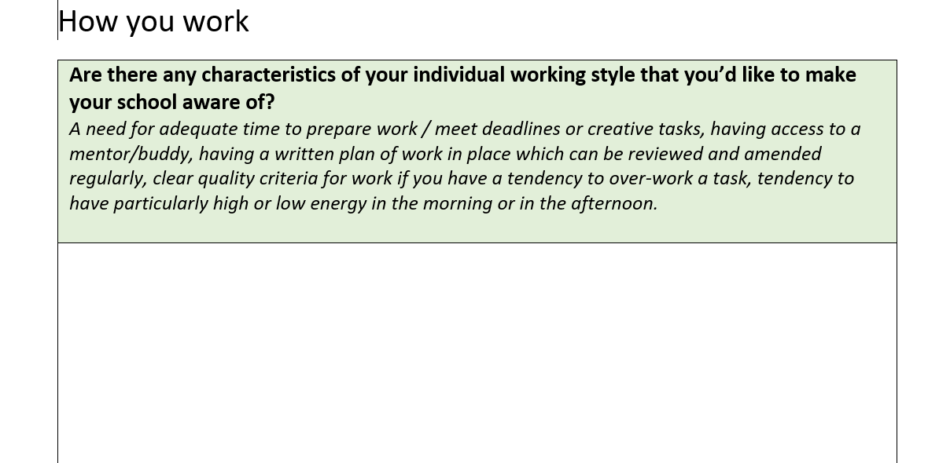
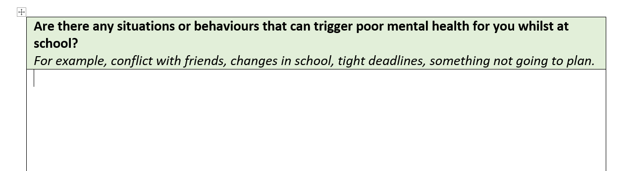
Action Plan
Framework

Slide 10
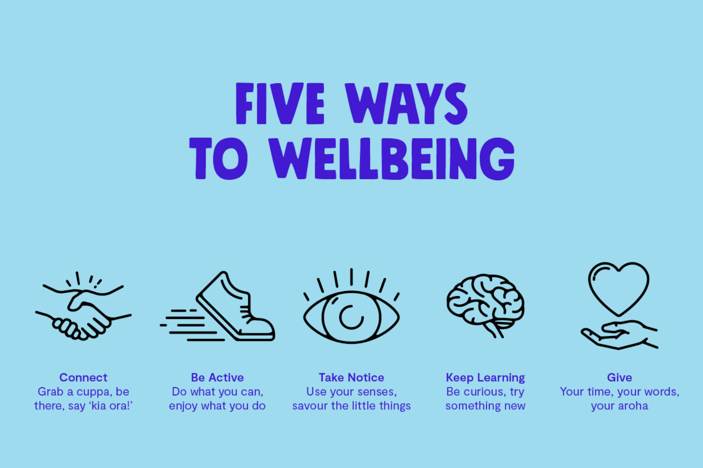
Five ways to wellbeing

Slide 11




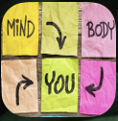


Slide 12
CONTACT US
Safeguarding@lgs.slough.sch.uk

Slide 13


Drop-in clinic
For any safeguarding or mental health support, please come to our first drop-in clinic on the Wednesday 3rd of January at 8:20 or 3:15.

Slide 14

Strategies
ACT
Identify triggers
Take time for yourself
Be kind to yourself
Connect with friends
Celebrate small successes
Set boundaries
Get the basics right
Ask for help
Learn to say no
Complete an action plan
Follow the five ways to wellbeing
Contact the school and GP or A&E
Visit us on the first Wednesday of every month.
© The Key Support Services Limited

Slide 15
