Slide 1


Raising Achievement at A Level
Year 12 Parent Information Evening

Slide 2
Introductions- The Sixth Form Team
Mr Harding Headteacher
Ms Makowski Director of Sixth Form
Mr Aplin Deputy Director of Sixth Form
Miss Butler Deputy Director of Sixth Form
Mr Berrow and Mrs Jenkins Sixth Form Senior Tutor
Mr Langford EPQ/Academic Mentor/ Oxbridge Pathway Lead.
Mrs Kirby Sixth Form Administrator/Student Manager
Sixth Form Tutors
Student Leadership Team Dhyan, Sanvi, Akaisha, Pavleen and Frankie

Slide 3
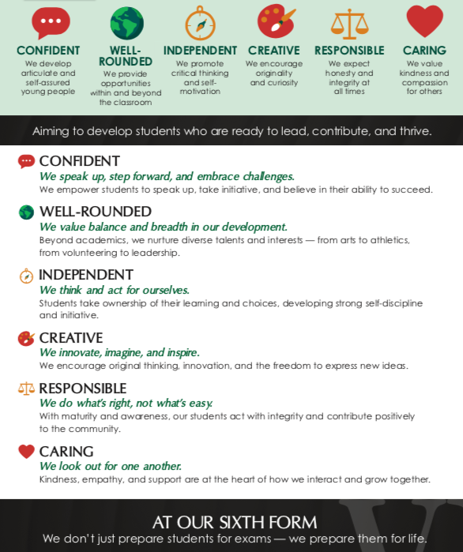
The Sixth Form Ethos

Slide 4
Class of 2025 Outcomes
A*-A grades 58.9%
A*-B grades 85.2%
A*-E grades 99.8%
138 achieved their first choice
69% Russell Group Universities
6 to Oxford/ Cambridge

Slide 5
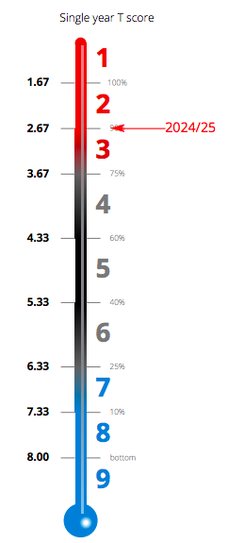
ALPS- Value Added 2024
ALPS Value Added

Slide 6
Class of 2025 Destinations

Slide 7

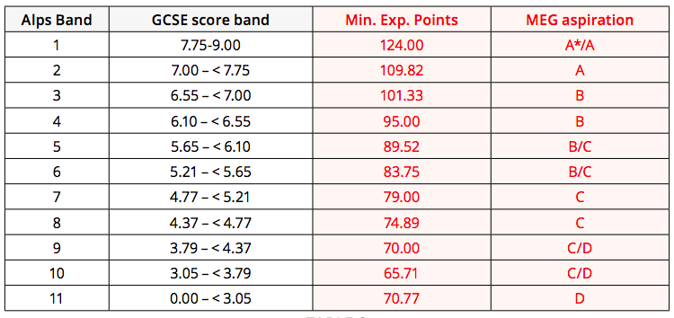
Creating Ambition with
Minimum Target grades

Slide 8
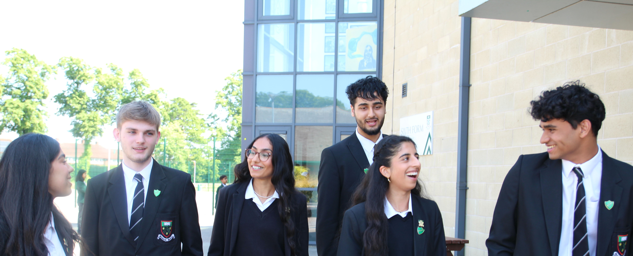
This year is hugely important
Year 1 lays the foundation for Year 2
Students need to have shown evidence that they will be successful at A level to continue into Year 2 in an A level subject.
The AS grade/s will be on university applications (UCAS)
Year 1 year provides the evidence for predicted grades for UCAS predictions which are published in September of Y13
University/ Apprenticeship offers are dependent on AS grade/s & predicted grades

Slide 9
Overview of next two years
September 2025 Commence A Level courses
December 2025 Assessment week and AS entries.
WB 13 April 2026 Internal Assessments
May 2026 AS Examinations
June/July Start University/Apprenticeship applications
August 2026 AS result/s published
Sept. 2026 Carry forward 3 or 4 subjects for A Level, UCAS Predicted Grades
Sept.– Nov. 2026 University/Apprenticeship applications
Jan 2027 A Level Practice Examinations
June 2027 A Level Examinations
August 2027 A level results published

Slide 10

Professional Predictions
V
UCAS Predicted Grades
Professional Predictions
These grades are published at each assessment point.
Teachers use professional judgement to decide what A level grade a student is ‘most likely’ to achieve if they continue to work at their current level.
We use laser grades:
eg. B1, B2, B3
These can increase or decrease based on the evidence students provide.
Predicted grades
These are always ‘realistically optimistic’ typically higher than a professional prediction and are published in September of Year 13.
These are based on evidence collected in each subject throughout Year 12 and at the very start of Year 13.
If a student would like an A or an A* UCAS prediction they will need to consistently achieve A and A* professional predictions in Year 12.

Slide 11
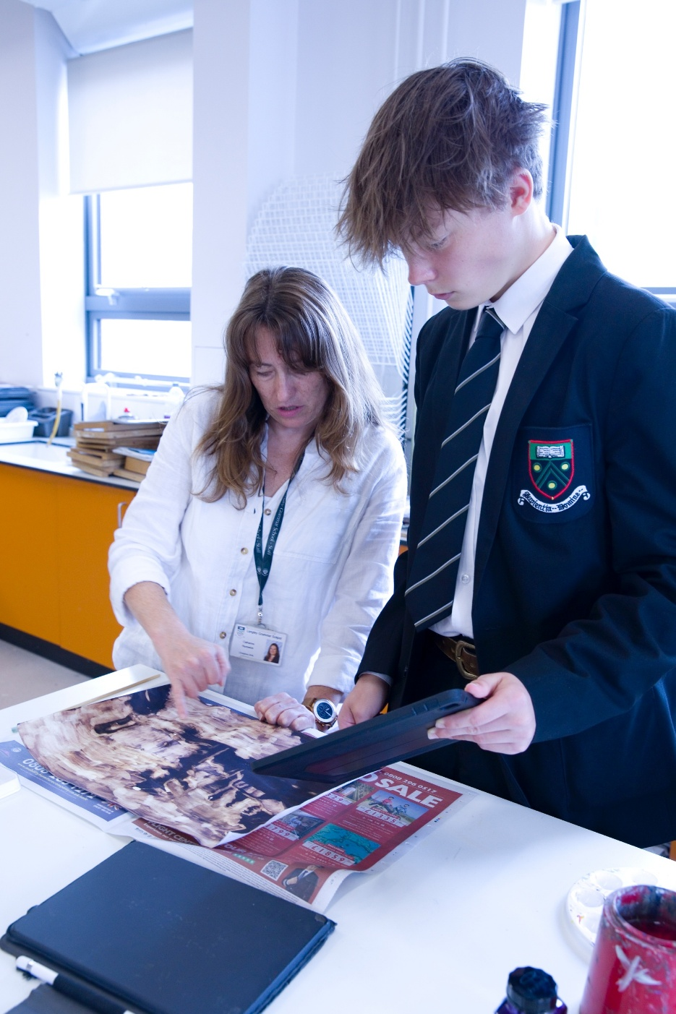
GCSE and A level study:
What is the difference?
Expectation of independent learning
Productive private study in school and at home
Course content much deeper and more intellectually demanding
Success demands consistent effort throughout the year
Need to engage with teachers outside lessons
Cannot recover lost ground in final few weeks before examinations
Revision needs to be continuous.

Slide 12

The Curriculum
9 periods per fortnight for each subject
1 period per week on an enrichment course of their choice
1 period of the Culture and Curiosity programme each week
1 period per week of Games (Wednesday P5)
Guest speaker lectures 1 period a fortnight

Slide 13
Getting the basics right
Uniform
Attendance and Punctuality
Organisation
Establishing good study habits
Notes:
Attendance- as close to 100% as students can, no routine medical or dental appointments in school time are authorized, no holidays. They can apply for 3 days of planned absence across an academic year, must be tracking towards the right grades and have good attendance to be authorised. Work experience as much as possible outside term time

Slide 14
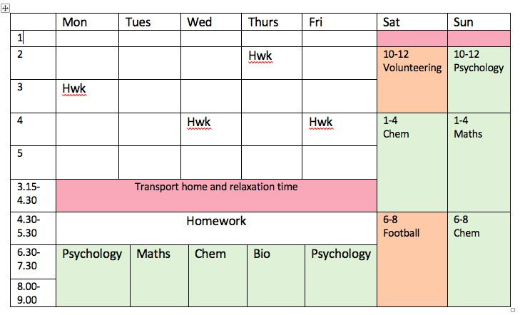
How should they organize their time?

Slide 15
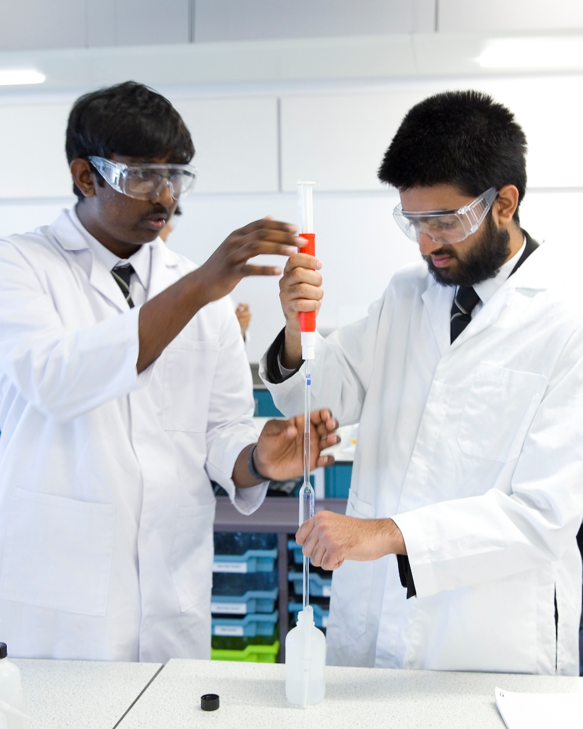
Independent Learning
Key Strategies
Student Handbook
Specifications/ PLCs
A task orientated study plan
Engaging with teachers outside lessons on how to improve.
Reading through class notes, 'adding to these’ and then completing topic questions.
Wider reading/ supercurricular

Slide 16

Independent Learning
Take personal responsibility for progress, asking teachers questions about how to attain the next grade up.
Be organised to use private study time at school and at home
Part-time job- no more than 8hrs per week (outside school hours).
Students should commit to spend as much time on their studies outside lessons as they do in lessons
Opportunity to carry out an ‘Extended Project’

Slide 17
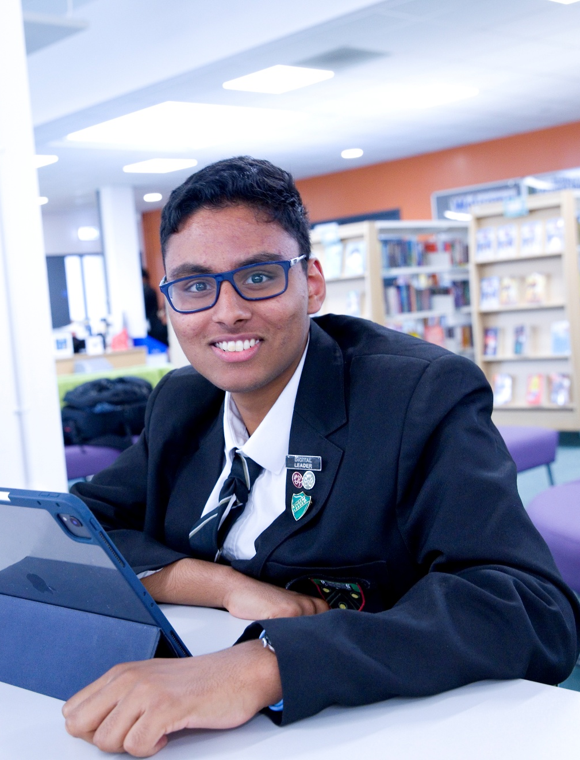
Study Spaces in School
Supervised Study Space- students need to complete a set number of independent study periods in here, linked to funding. These are spent in the silent study areas- the Library and the Sixth Form Supervised Study Area.
Quiet working areas for collaboration and group work- The Dining Room and the Study Room.

Slide 18

Monitoring Progress
Transition Work assessed broadly
Tutor Review after 6 wks
Grade ranges and Parent/Teacher Consultation 1 - Monday 10 November
Assessments 8-19 December informing decisions about AS entry.
Tutor Review - WB 26 January
Year 12 Practice Exams and Provisional UCAS predictions - 13-17 April
Parent/teacher Consultation 2- Tuesday 9 June
Pastoral/ Subject Intervention at each assessment point and academic mentoring available to those who are identified as needing support
Academic Excellence Programme

Slide 19
Support from school
Subject Teachers
Personal Tutors
Academic mentoring
Weekly newsletter
UNIFROG/ CTM Pathways
Specialist Pathways
Careers Adviser
What is Study Deficit?
If students are asked to make up study deficit time after school on a Friday. You will be notified on Class Charts
Subject teachers will continue to set their own study deficits.

Slide 20

Support from home
Reinforce the messages about personal organisation and regular commitment of time to personal study
Help to identify good times, realistic planning
Studying downstairs
Screentime/ distractions
Support good working practices

Slide 21



Beyond the curriculum
Passport for Life Programme
The Sixth Form is also about gaining broader experience and developing as a well rounded individual:
Enrichment opportunities
Participation in sport / community service / mentoring projects
Student Leadership
Reading around subjects ………..
Super-curricular opportunities
EPQ
University Lectures
Journals- library and online
Work experience/shadowing: ESSENTIAL for vocational courses (e.g. Healthcare, Teaching, Law, Journalism, Architecture, Accountancy); DESIRABLE for many others
Volunteering: www.do-it.org.uk

Slide 22
Sixth Form Careers Programme
Enrichment (ongoing) Careers Talks
‘Getting into Competitive Universities’
October CTM Pathways Launch assembly and Unifrog
January Professional and Industry Expert Speednetworking Event
UCAS Information for Parents
From March onwards One-to-one careers interviews start
March What Next? University and Apprenticeship Fair
June Passport for Life Day
June/July/Sept: University Open Days- leave days
By end of summer term: First draft of Personal Statement 1:1 support

Slide 23
We asked Year 12 at the end of last year……
How have you changed the way you learn this year?
What are the biggest differences between Year 11 and Year 12?
What do you wish you had known at the start of Y12?
'I now do more exam questions and carry out in-depth study into every topic'
'Independent learning, depth of subject, level of difficulty and the workload'
'How important time management is'

Slide 24

Notes to your younger self….
Last minute revision will not get you a good grade
Make further notes after every lesson to enhance your understanding of the subject
If you have any question in the class, ask there and then.
Be true and honest to your self, and don’t fall into the parental and society pressure
Know all of your GCSE content before starting Sixth Form
Don’t be late to lessons, it is disruptive to other students and you miss out on learning
Utilise your independent studies. This saves you time at home to get more revision done.
Take advantage of mentoring opportunities and the opportunities in the newsletter.
Ask teachers for help and advice when you need it – don’t wait until you are really struggling
It is important to make revision resources after the lesson, rather than waiting and letting the content build up. Making flashcards and other Revision resources will help retain knowledge for the future

Slide 25

Summary and Questions

