Slide 1
Langley Grammar School Raising Achievement at A Level
Information Evening for Year 12 Parents

Slide 2
Overview of next two years
September 2022 Commence A Level courses
January 2023 Subject Assessment week, provisional decision about fourth subject.
May 2023. Internal Exams
May 2023 AS Examinations
June/July Commence university application process (UCAS), or alternative options
August 2023 AS result/s published
Sept. 2023 Carry forward 3 or 4 subjects for A Level, UCAS Predicted Grades
Sept.– Nov. 2023 Finalise university applications (or alternatives)
Jan 2024 A Level Practice Examinations
June 2024 A Level Examinations
August 2024 A level results published

Slide 3
Course structure
Year 12: Three or four subjects with 2 or 3 units in each subject
Year 13: Typically three subjects taken to A level, again with 2 or 3 units in each subject
Final A level grade based on A level units ONLY taken in June 2024.

Slide 4
This year is hugely important:
Year1 lays the foundation for Year 2
Progression to Y2 in an individual subject is dependent on achievement in Y1 students have not shown evidence that they will be successful at A level will not normally progress to Y2 in that course.
The AS grade/s will be on university applications (UCAS)
This year provides the evidence for predicted grades for UCAS. Published Sept of Y13
University offers are dependent on AS grade/s & predicted grades

Slide 5
Target grades Mean GCSE score and Minimum target A level grades
GCSE Average Point Score | Indicative Grade Outcomes
7.5-8.0 | A*AAA/A*AA
7.0-7.5 | AAA
6.7-7.0 | ABB
6.4-6.7 | BBB
6.1-6.4 | BBC
5.8-6.1 | BCC
5.8-6.1 | CCC
5.5-5.8 | CCD
5.2-5.5 | CDD
4.7-5.2 | CDD/DDD
4.0-4.7 | CDD/DDD

Slide 6
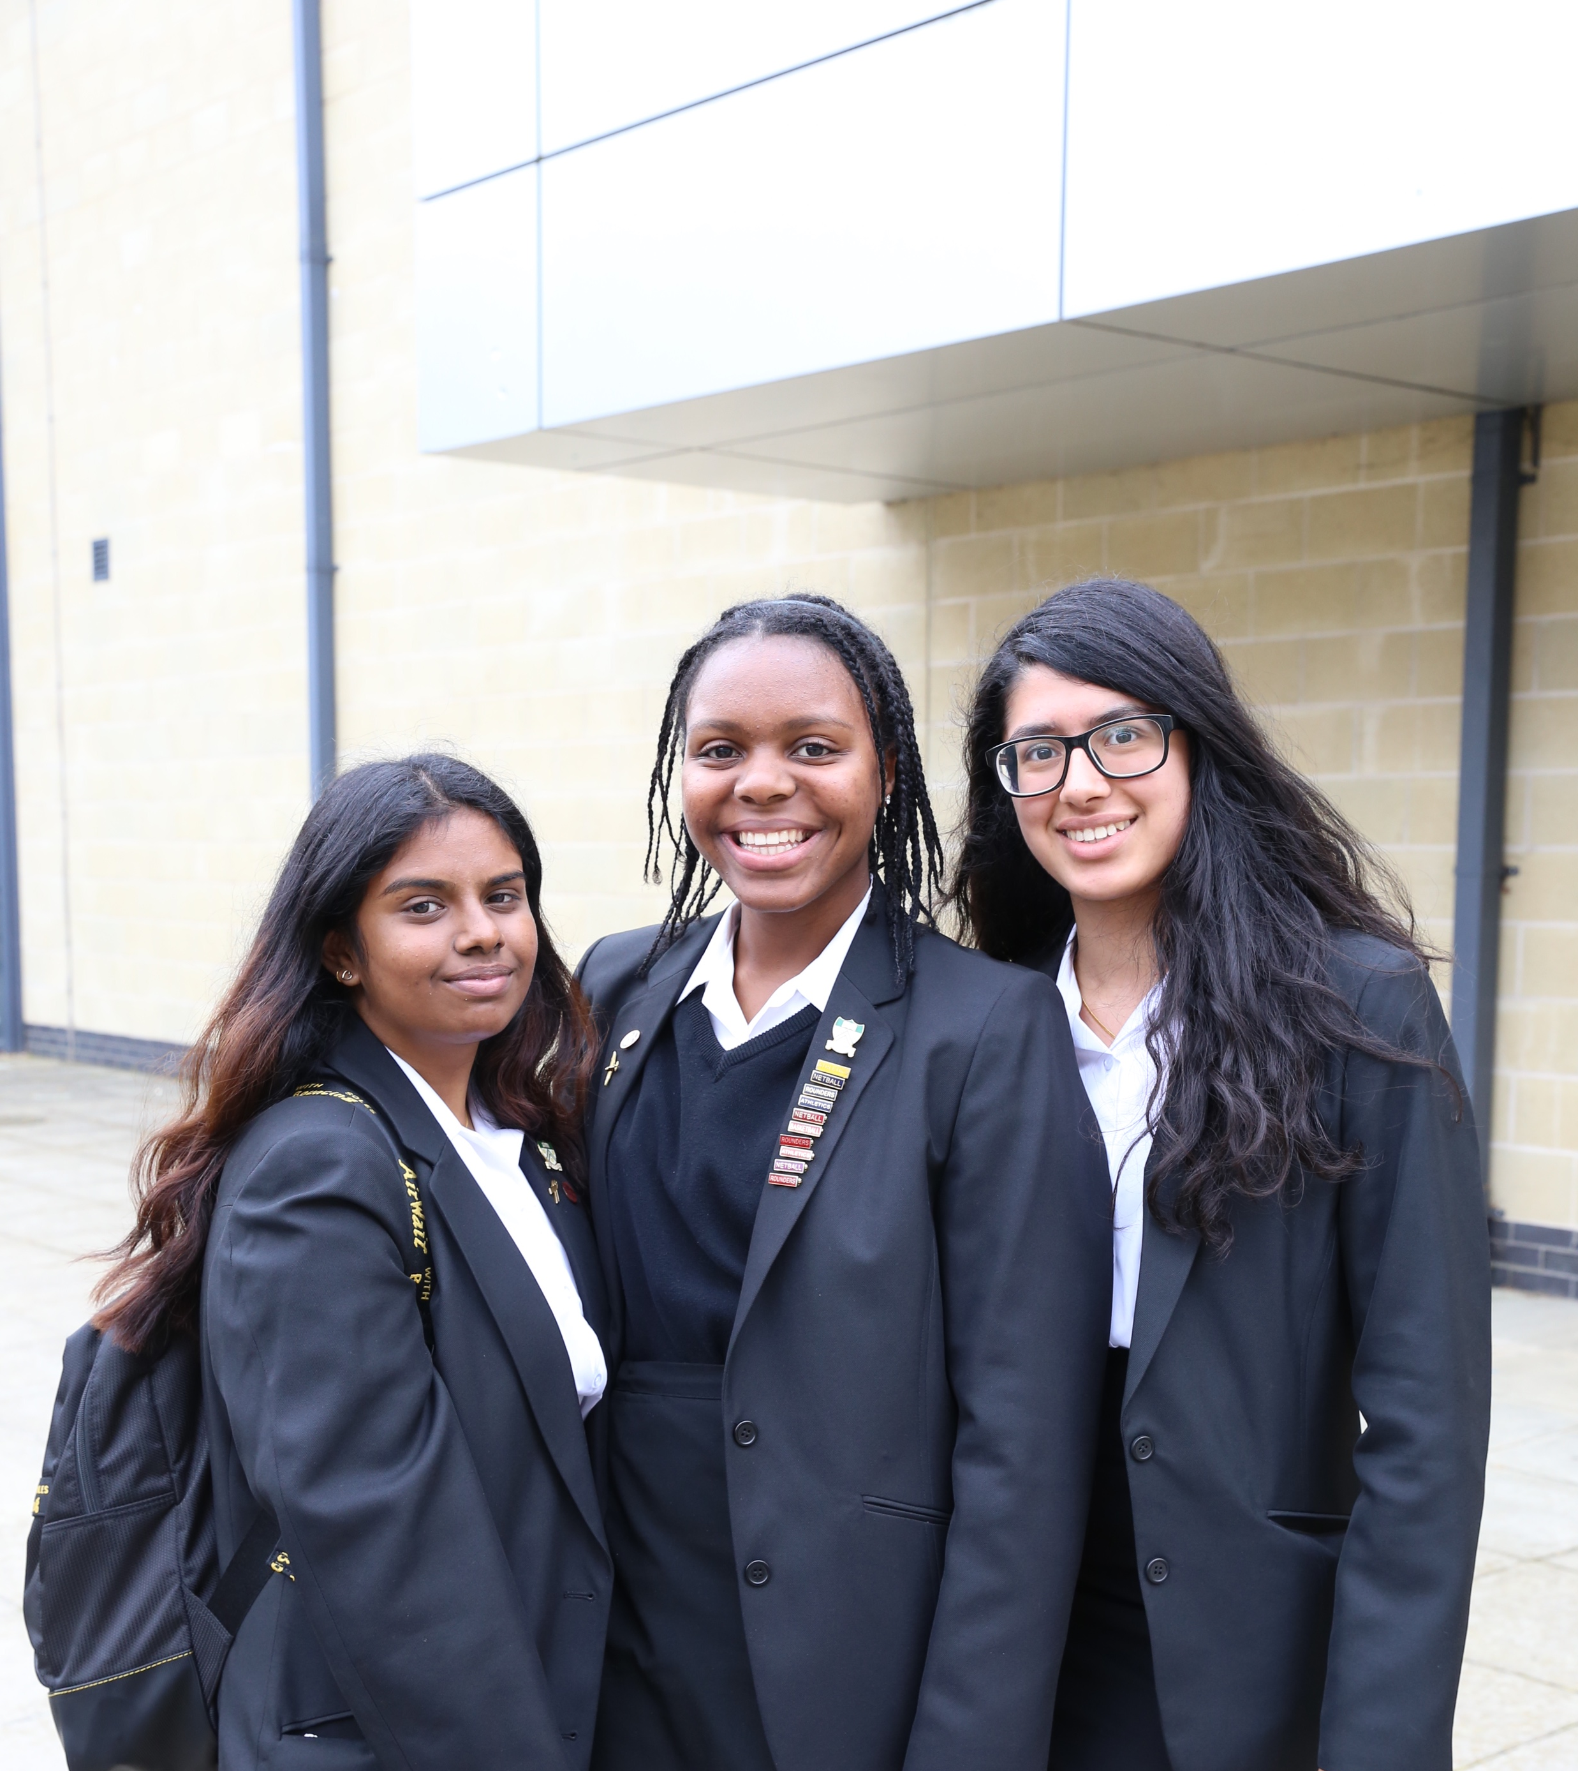
GCSE and A level study: What is the difference?
Expectation of independent learning
Productive private study in school and at home
Course content much deeper and more intellectually demanding
Success demands consistent effort throughout the year
Need to engage with teachers outside lessons
Cannot recover lost ground in final few weeks before examinations
Revision needs to be continuous.

Slide 7
Independent Learning
Take personal responsibility for progress, asking teachers questions about how to attain the next grade up.
Be organised to use private study time at school and at home productively.
Part-time job- no more than 8hrs per week (outside school hours).
Students should commit to spend as much time on their studies outside lessons as they do in lessons
Opportunity to carry out an ‘Extended Project’

Slide 8
Independent Learning
Key Strategies
Student Handbook
Specifications/ PLCs
Wider reading
3hrs each evening
A task orientated study plan
Engaging with teachers outside lessons on how to improve.
Reading through class notes, ‘fleshing these out’ and then completing topic questions.

Slide 9
Choice of Study Spaces
Supervised Study Space- students need to complete a set number of independent study periods in here, linked to funding. These are spent in the silent study areas- the Library and the Sixth Form Supervised Study Area.
Quiet working areas for collaboration and group work- The Dining Room and the Study Room.

Slide 10
Monitoring Progress
Transition Work - assessed broadly
Tutor Review - after 6 wks- 10 October
Parent/Teacher Consultation 1 - 01 November
Assessment Week WB 12 December –decisions about AS entry.
Tutor Review- January
End of Year 12 Practice Exams (week beginning 24-28 April) and Provisional predictions
Parent/teacher consultation 2 Wed 14 June
Pastoral/ Subject Intervention at each assessment point and academic mentoring available to those who are identified as needing support

Slide 11
Support from school
Subject Teachers
Tutors
Academic mentoring
UNIFROG/ CTM Pathways
Specialist Pathways
Careers Adviser
What is Study Deficit?
Or if students are asked to make up study deficit time after school on a Friday.
-you will be notified on Class Charts
- an email will be sent home
- please acknowledge by emailing studydeficits@lgs.slough.sch.uk
Subject teachers will continue to set their own study deficits.

Slide 12
Support from home
Reinforce the messages about personal organisation and regular commitment of time to personal study
Help to identify good times, realistic planning
Studying downstairs
Screentime/ distractions
Support good working practices

Slide 13
Beyond the curriculum Passport for Life Programme
The Sixth Form is also about gaining broader experience and developing as a well rounded individual:
Enrichment opportunities
Participation in sport / community service / mentoring projects
Student Leadership
Reading around subjects ………..
Super-curricular opportunities
University Lectures
Journals- library and online
Work experience/shadowing: ESSENTIAL for vocational courses (e.g. Healthcare, Teaching, Law, Journalism, Architecture, Accountancy); HIGHLY DESIRABLE for many others
Volunteering: www.do-it.org.uk

Slide 14
Key Dates: post-18 options
Enrichment (ongoing) Careers Talks
‘Getting into Competitive Universities’
October Pathways Launch assembly and Unifrog
January Professional and Industry Expert Speednetworking
From March onwards: One-to-one interviews start
March What Next? University and Apprenticeship Fair
June UCAS Information for Parents
Passport Creation Week- Focus Day
June/July/Sept: University Open Days
By end of summer term: First draft of Personal Statement 1:1 support

Slide 15
Questions and summary

