Slide 1
ENGLISH GCSE(S) How to do well? How can you support your child?

Slide 2
English Language
Component 1 – 2 part exam worth 40%
Questions about a C20th prose text
Creative writing
Component 2 – 2 part exam worth 60%
Questions about C19th and C21st non-fiction texts
Transactional/persuasive writing
Component 3 – Teacher assessed speech, does not contribute to the overall grade.

Slide 3
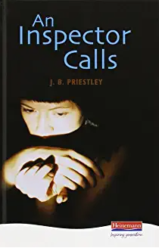
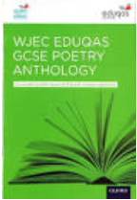
English Literature
Component 1 – 2 part exam worth 40%
Questions on a Shakespeare play (Romeo and Juliet)
Questions on poetry studied in class (Poetry Anthology)
Component 2 – 3 part exam worth 60%
Questions on Post 1914 novel/play (An Inspector Calls)
Questions on a C19th novel (Christmas Carol)
Questions on previously unseen poetry

Slide 4
How to prepare?
Be organised from lesson one – have all the texts, post-it notes, highlighters, lined paper.
Plan and edit the writing – successful writers take time and aim to improve their final ‘product’.
Revise regularly – a lot of content has to be committed to memory.
Read and then read more – variety of genres – short stories, novels, poems, articles, reports – anything and everything.

Slide 5
Lessons learnt from previous years...
Students independently produce revision notes for key quotations, characters and themes from the start of Year 10.
Critical thinking skills are paramount for grades 8 and 9 – no ‘revision guide style’ answers.
English Language creative writing skills is a key area for development. Students should be reading as many short stories and creative fiction as possible.
Comprehension, skimming and scanning skills are skills that can be developed. Students need to practise reading and summarising a variety of fiction and non-fiction texts.

