Slide 1
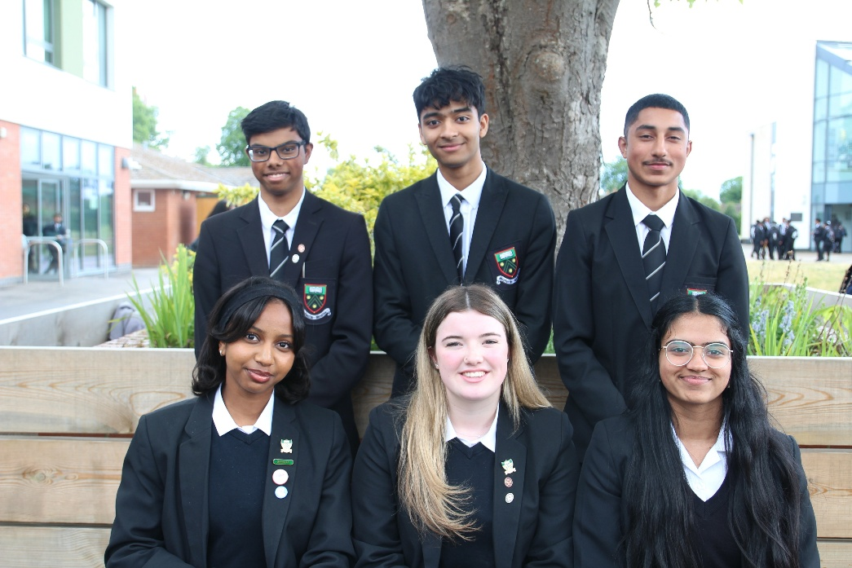

Year 13 Raising Achievement Evening
10 September 2026

Slide 2

Mobile Phones & Smart Devices
The Department for Education expects schools to be mobile phone-free by default.​
This applies to all students at Langley Grammar School, including Sixth Form.

Slide 3
2026 A Level Outcomes
A*-A grades 53.2%
A*-B grades 82.3%
A*-E grades 99.8%
132 achieved their first choice
66% Russell Group Universities

Slide 4
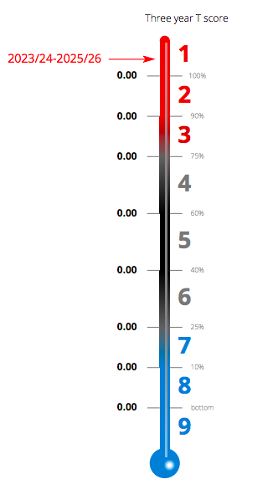
ALPS Value Added
2024-26

Slide 5
Where are they going?

Slide 6
What are they reading?

Slide 7

First Steps
Review
Review Year 1 results to identify strengths and weaknesses.
Choose
Choose 3 (or 4) subjects to continue to A Level which build on Year 1 successes
Review
Review approach last year- use of time, engagement with teachers outside lessons.

Slide 8
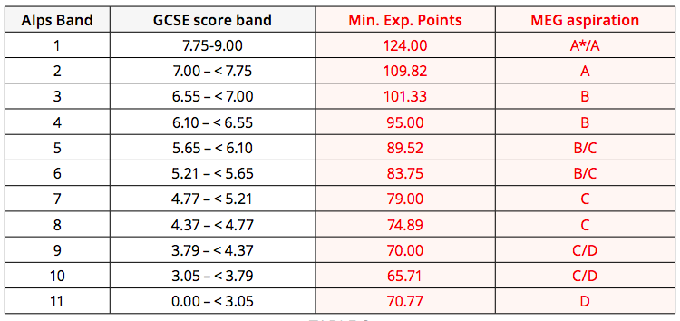
Minimum target A level grades
Based on average GCSE point score

Slide 9
Predicted Grades
'Universities and colleges take much more than just grades into consideration when deciding whether to offer a place – things such as the personal statement, relevant experience, interview performance, your motivation, and commitment to study. They also consider the overall demand for places on the course, and the success of past students who achieved the same A level grades as you are predicted. Remember, this is an estimate based solely on past applications from other people studying the same A levels and with the same predicted grades.’ Source: ucas.com
Our predictions at Langley Grammar School are based on evidence and allow for progress in Y13 and in addition are ‘optimistically realistic’

Slide 10
Inflating Predicted Grades
Universities have lists of schools who do
Universities provide fewer offers to institutions that inflate their grades.
Students receive higher offers that they are likely to achieve on results day.
ALPS target grades as predictions- do not enable students who have not achieved well at GCSE to show progression in the Sixth Form.

Slide 11
Predicted Grades at Langley Grammar School

Slide 12
How realistically optimistic are we?
In summary in 2026.
We predicted an average point score across the subjects across the cohort of 50.31 (49.86 in 2025) points.
The actual average point score across the subjects across the cohort was 44.74 (45.53 in 2025) points
Our predictions were generous by 5.57 points (4.33 points in 2025),
10 points is a grade = by 0.55 (0.43 in 2025) of a grade.

Slide 13
UCAS References
Section 1- School Context (compulsory)
Section 2- Extenuating circumstances/ support provided at school (optional)
Section 3-,Supportive Academic Information (optional)

Slide 14

Post 18 Pathways
Applying to University- full degree, foundation degree
Applying for Higher Apprenticeships
Applying for Degree Apprenticeships
Gap Year- structured
Careers advice and support limited to non-existent when they leave school.

Slide 15

What is happening?
Supervised Study Report
Academic Mentoring
Guidance/ support from subject teachers
One-to-one personal statement support

Slide 16
Assessment Points
W/B 21 September- UCAS predicted grades issued
W/B 15 October- Parent Teacher Consultation 1
W/B 04 January- Y13 Practice Exams
Late February- Tutor/Student Reviews
June- Public Examinations begin
Thursday 12 August 2027 Results Day

Slide 17
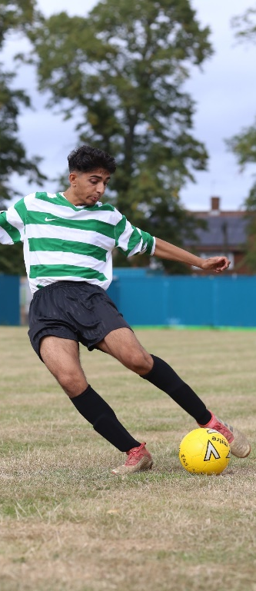
Good attendance is key
As close to 100% as possible
Evidence shows poor attendance correlates to poor outcomes. All 4 students who underachieved in all 3 of their subjects attendance was a factor in all cases.
Routine appointments outside school hours
Applicant days/ interviews.

Slide 18

Attitude is key
Getting Post 18 pathway applications in early
Unremitting approach
Proactive with teachers
Completing additional work to tasks set by the teacher, which is shown to the teacher.
Spreadsheet of past papers and their scores

Slide 19
Making progress at A Level
Make it happen!
Remember Year 2 is harder than Year 1
Ask for advice from teachers in areas of uncertainty and about how to achieve the next grade up (within and outside lessons as you go through the course
Use the exam specification as a checklist, Checking their revision against these or PLCs
Review lesson content afterwards, complete topic past paper questions and read ahead for the next
Mobile free school. At home, use distraction blocker apps –self/parental control.

Slide 20

Independent Learning
Take personal responsibility for progress
Universities want people who have a real interest in studying the subject and can show evidence of this.
Productive use of the different study spaces
Think about what achieves an A*

Slide 21
Support from home
Personal Organisation
Places to study
Support good working practices
Remove distractions
Are they talking to teachers outside lessons?
Start revision early, this is their independent learning.
What is the plan for UCAS applications?
UCAS website

Slide 22
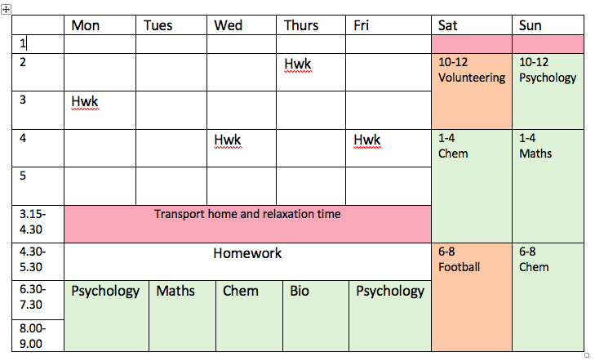
How should they organise their time?
Student Handbook/ iStudiez Pro

Slide 23

What is the UCAS Process?
Predicted Grades out now
Students complete the UCAS form online and print a hard copy to submit to us. Date logged
Process of writing the reference 3 weeks
We show them the reference
They wait to hear… offers, interviews…
Select a firm and an insurance- June deadline
Student finance applied for by May 31 2027
Results day confirm their option

Slide 24
Key elements to the UCAS Application Form
Personal Statement- one-to-one support with their tutor
Pathway students- have been fast-tracked.
A range of universities.
Reference- subject reference which are collated by the tutor and then checked by an approver, read by the student before being sent to UCAS.

Slide 25

Key UCAS
Submission Dates 2026/27
School Deadlines
Oxbridge, Medicine, Dentistry, Veterinary Science by 23 September
Other competitive courses (Russell Group universities) by 09 October
All other UCAS applications by 6 November
UCAS Deadlines
Early Applicants by 18.00 on 15 October
All others by 18:00 on 13 January 2027

Slide 26

Self Release
If your son/ daughter has an offer in the UCAS cycle
Achieves better grades than this offer
Can phone around as many universities that have places in adjustment.
If students decide they no longer want to go to their insurance choice.
Opt to self release on results day and opt to go through clearing.

Slide 27

What if they do not achieve their offers?
Clearing
Track delivers the news early on results day.
Clearing number.
UCAS website and university websites display vacancies.
Applying the following year
Is it worth it?
Resits and UCAS support we only have limited resources.
Making good use of their Gap Year.
Better to apply this year for something- opens doors.

Slide 28
Summary and Questions

