Slide 1


Langley Grammar School
Raising Achievement at A Level
Wednesday
21 September 2022

Slide 2
2022 A Level Outcomes
A*-A grades 71.5%
A*-B grades 85%
A*-C grades 94%
140 achieved their first choice
57% Russell Group Universities
8 to Oxbridge

Slide 3
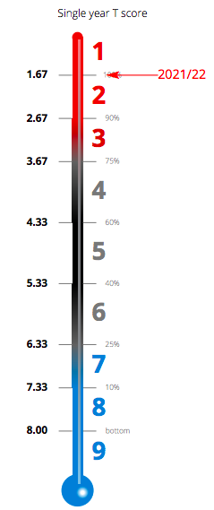
Value Added Progress

Slide 4
Where have they gone?

Slide 5
What are they reading?

Slide 6

First steps
Review
Review Year 1 results to identify strengths and weaknesses.
Choose
Choose 3 (or 4) subjects to continue to A Level which build on Year 1 successes
Review
Review approach last year- use of time, engagement with teachers outside lessons.

Slide 7
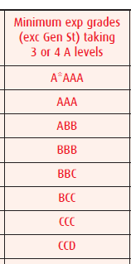
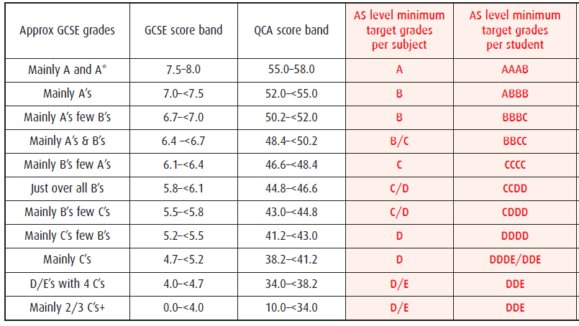
Target grades
Mean GCSE score Minimum target A2 level
grades /UCAS points (A*=56 A=48, B=40, C=32, D=24,E=40)

Slide 8
The A* grade at A Level
The A* grade for full A level was awarded for the first time in August 2010
Aim is to allow universities and employers to differentiate between candidates with top grades
A* grade is awarded to candidates who attain grade A standard overall AND achieve over 90% on the aggregate of their A Level units
There is no A* award at AS level apart from in the EPQ qualification.

Slide 9
Converting Y1 grades to A level results
(LGS 2019)
A level Grade
 | A* | A | B | C | D | E | U
A* | 15 | 6 |  | 1
A | 19 | 69 | 52 | 8 | 1
B | 1 | 44 | 79 | 29 | 3 | 2 | 1
C | 1 | 7 | 24 | 35 | 11 | 7 | 3
D |  |  | 3 | 14 | 5 | 8
E |  |  |  |  | 1 | 1
U
PP Y1
Grade
Total No.
36 126 158 87 21 18 4

Slide 10

UCAS Predicted Grades
'Universities and colleges take much more than just grades into consideration when deciding whether to offer a place – things such as the personal statement, relevant experience, interview performance, your motivation, and commitment to study. They also consider the overall demand for places on the course, and the success of past students who achieved the same A level grades as you are predicted. Remember, this is an estimate based solely on past applications from other people studying the same A levels and with the same predicted grades.’ Source: ucas.com
Our predictions at Langley Grammar School are based on evidence and allow for progress in Y13 and in addition are ‘optimistically realistic’

Slide 11
Inflating Predicted Grades
Universities ignore them
Universities provide fewer offers to institutions that inflate their grades.
Students receive higher offers that they are unable to achieve on results day.
ALPS target grades as predictions- does not enable students who have not achieved well at GCSE to show progression in the Sixth Form.

Slide 12
How accurate are
Langley Grammar School Predictions
Pass Grades | Pass Points
A* | 60.00
A | 50.00
B | 40.00
C | 30.00
D | 20.00
E | 10.00

Slide 13
A fine line between inflation and giving students ‘the benefit of the doubt’ on the evidence we have collected.
In summary in 2021.
We predicted an average point score across the subjects across the cohort of 45.1 points.
The actual average point score across the subjects across the cohort was 38.3 points
Our predictions were generous by 6.8 points,
10 points is a grade = just over two thirds of a grade.

Slide 14
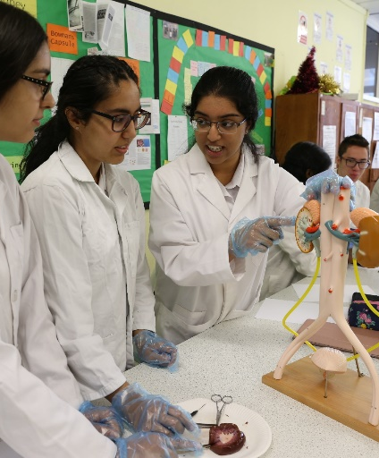
Post 18 Pathway decisions
Applying to University- full degree, foundation degree
Applying for Higher Apprenticeships
Applying for Degree Apprenticeships
Gap Year- structured
Careers advice and support limited to non-existent when they leave school.

Slide 15
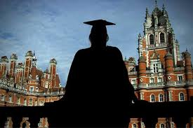








Post 18 options
University or another route?
Gap year?

Slide 16



Post 18 options
If applying to university:
balance between aspiration and realism
must take predicted grades into account
vital to include sensible ‘insurance’ back-up option(s)

Slide 17
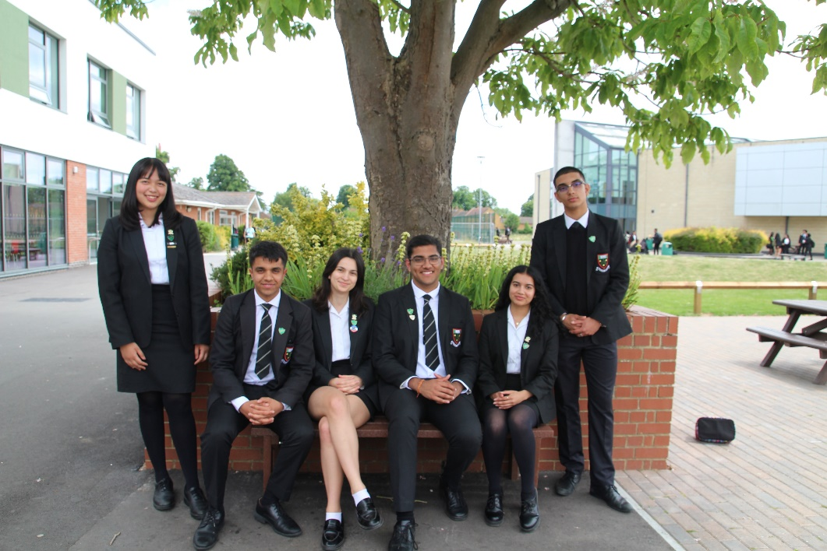
What is happening?
Sixth Form Success Proformas
Supervised Study Report
Academic Mentoring
Guidance/ support from subject teachers
One to one personal statement support

Slide 18
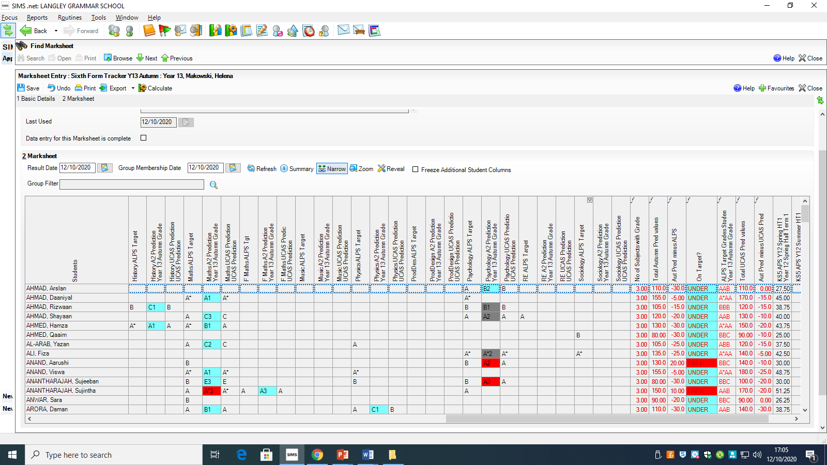
What is happening?

Slide 19
Assessment Points
23 September- UCAS predicted grades issued
Thursday 20 October- Parent Teacher Consultation 1
WB 02 January- Y13 Practice Exams
WB Tuesday 28 February- Parent Teacher Consultation 2
June- Public Examinations begin
Thursday 17 August 2021 Results Day

Slide 20
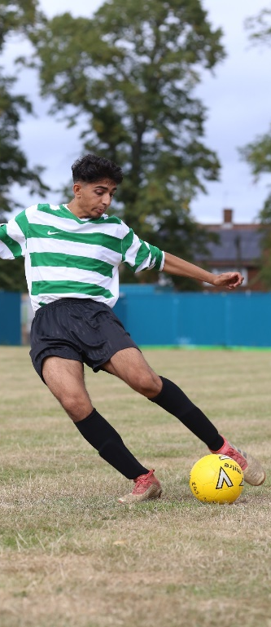
Good attendance is key
As close to 100% as possible
Evidence shows poor attendance correlates to poor outcomes. All 4 students who underachieved in all 3 of their subjects attendance was a factor in all cases.
Routine appointments outside school hours
Applicant days/ interviews.

Slide 21

Attitude is key
Getting Post 18 pathway applications in early
Unremitting approach
Proactive with teachers
Completing additional work to tasks set by the teacher, which is shown to the teacher.
Spreadsheet of past papers and their scores

Slide 22
Making progress at A Level
Make it happen!
Use distraction blocker apps
Self control or cold turkey
Seneca
ACTION NOT WORDS
Use the exam specification as a checklist,
Checking their revision against these or PLCs
Remember Year 2 is
HARDER than Year 1
Ask for advice from teachers in areas
of uncertainty and about how to achieve
the next grade up (within and outside
lessons as you go through the course)
Review lesson
content afterwards,
complete topic past paper
questions and read ahead
for the next
Look at commitments
outside school
Don’t put things off

Slide 23
Independent Learning
If there is an interest
in your subjects why
would working for them
be an issue?
Universities want people
who have a real interest
in studying the subject and
can show evidence of this.
Make a study plan, homework completed during independent study periods at school.
Commit to at least
30-40 hours per week of study
(typically 15-20 hours in lessons)
Take personal responsibility
for progress
All independent study periods
spent in the library or supervised area
Good grades
don’t fall from the sky-
the need to work
Be organised to use
private study time at school
and at home productively
Think about what
achieves an A*

Slide 24
Support from home
Reinforce the messages about personal organisation and regular commitment of time to personal study
Help to identify good times (and places) for study- is it best for them to be in their room?
Support good working practices e.g. an hour’s quality study followed by a ten minute break etc.
Reinforce focused study, no distractions
Ask them questions- have their asked their teachers how to reach the next grade? How many have they spoken to outside lessons this week.
Have they started revision? That is their independent learning.
What is the plan for UCAS applications? Apply 2023, Adjustment, Apply 2024
http://www.ucas.com/how-it-all-works/undergraduate/results/better-than-expected

Slide 25
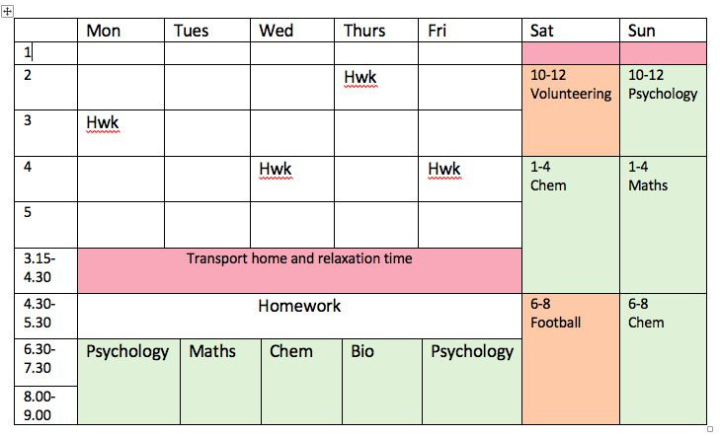
How should they organize their time?
Student Handbook/ iStudiez Pro

Slide 26
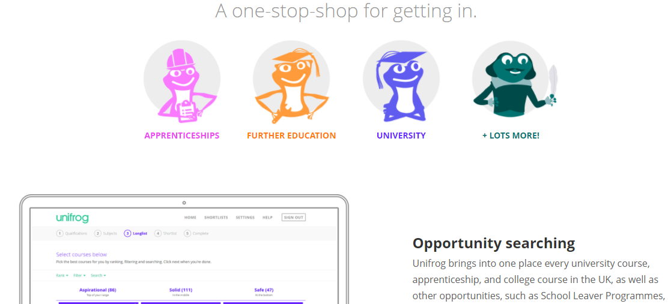
What is ‘Unifrog’?
Login Code- langleygrammarparents

Slide 27
To help their research ......
Use resources in Careers & Higher Education section on the LGS website > from Main Menu, go to ‘Student Activities’ or ‘Sixth Form’
Revisit Life after Langley Grammar presentation on ‘Options at 18’ page:
  Apply to University → Medical School, Oxbridge & Studying Abroad
  Apprenticeships & School Leaver Schemes
  CTM Pathways
  Taking a gap year
Make an appointment to see Mr Devani.
‘Unifrog’- destination search tool

Slide 28

What is the UCAS Process
Predicted Grades out now
Students complete the UCAS form online and print a hard copy to submit to us. Date logged
Process of writing the reference 3 weeks
We show them the reference
They wait to hear… offers, interviews…
Select a firm and an insurance- April/May
Student finance applied for by May 31 2023
Results day confirm their option

Slide 29
Key elements to the UCAS Application Form
Personal Statement- one-to-one support with their tutor
Pathway students- have been fast-tracked.
Predicted Grades- range of universities.
Reference- subject reference which are collated by the tutor and then checked by an approver, read by the student before being sent to UCAS.

Slide 30

Key UCAS Submission Dates 2022/23
Oxbridge, Medicine, Dentistry, Veterinary Science by 20 September
Other competitive courses (Russell Group universities) by 7 October
All other UCAS applications by 4 November
UCAS Deadlines
Early Applicants 18.00pm 15 October 2022
All others 18:00pm 25 January
School Deadlines

Slide 31

Self Release
If your son/ daughter has an offer in the UCAS cycle
Achieves better grades than this offer
Can phone around as many universities that have places in adjustment.
If students decide they no longer want to go to their insurance choice.
Opt to self release on results day and opt to go through clearing.

Slide 32

What if they do not achieve their offers?
Clearing
Track delivers the news early on results day.
Clearing number
UCAS website and university websites display vacancies. (Superstar scheme KCL)
Applying the following year:
Is it worth it?
Resits and UCAS support we only have limited resources.
Making good use of their Gap Year.
Better to apply this year for something- opens doors.

Slide 33
Summary and Questions

