Slide 1

Parent Forum
Online risks and
how to keep children safe online

Slide 2

Online risks and how to keep children safe online
Give you information about the main online risks for students
Explain what we do in school to keep students safe online
Provide up to date information about the potential dangers of specific apps which students may be using
Give you some examples of how you can help keep your children safe online at home
Signpost you to further sources of advice and guidance

Slide 3

What is online safety?
It means protecting children from 4 main areas of risk:
Content: being exposed to illegal, inappropriate or harmful material online
Contact: being the victim of harmful interactions online
Conduct: behaving in a way online that causes harm or increases the likelihood of it
Commerce: risks like online gambling, inappropriate advertising, phishing or financial scams
© The Key Support Services Limited

Slide 4

Online Risks
Bullying and abuse
Sharing nudes and semi-nudes
Encourage harmful behaviour
Exposure to dangerous content
Bitcoin and gaming
Social media apps

Slide 5

Apps: they aren’t that big a deal, are they?
87% of 12 to 15 year-olds, 44% of 8 to 11 year-olds, and 30% of 5 to 7 year-olds who go online use social media sites or apps
57% of 5 to 7 year-olds have their own tablet
27% of 8 to 11 year-olds have seen worrying or nasty content online
83% of 8 to 11 year-olds who use social media or messaging sites/apps feel there’s pressure to look popular
95% of 12 to 15 year-olds say that people are mean or unkind to each other on social media, messaging or video sharing platforms
88% of girls report that being sent pictures or videos they didn’t want to see happens ‘a lot’ or ‘sometimes’ between people their age
80% of girls report that being put under pressure to provide sexual images of themselves happens ‘a lot’ or ‘sometimes’ between people their age
© The Key Support Services Limited

Slide 6







Apps to look and listen out for, and why
What do you know about this app?
What do you think is the minimum age to use it?
What do you think the main risks are?
© The Key Support Services Limited

Slide 7
Apps to look and listen out for, and why
WhatsApp
Instant messaging in one-to-one and group chats, and calls. Allows you to send messages, images, videos and your location
Age 16+
Children can be at risk of:
  Bullying
  Sharing nudes and semi-nudes
  Grooming
© The Key Support Services Limited

Slide 8
Apps to look and listen out for, and why
Instagram
Picture and video-sharing. You can post content publicly or to ‘followers’, see content posted by others, ‘follow’ each other, ‘like’ posts, comment, and send messages
Age 13+
Children can be at risk of:
  Grooming
  Exposure to upsetting or harmful material
  Bullying
  Pressure to look a certain way
© The Key Support Services Limited

Slide 9
Apps to look and listen out for, and why
Snapchat
Picture, video and message-sharing with contacts. The ‘snap’ is on screen for up to 10 seconds, then disappears; or you can opt for no time limit. You can share snaps in a sequence for up to 24 hours
Age 13+
Children can be at risk of:
  Grooming
  Sharing nudes and semi-nudes, and image-sharing without their consent
  Bullying
© The Key Support Services Limited

Slide 10
Apps to look and listen out for, and why
TikTok
Video-sharing. You can record and upload short video clips, watch other people’s videos, ‘follow’ people, gain ‘fans’, ‘like’ and comment
Age 13+
Children can be at risk of:
  Exposure to explicit or inappropriate videos, and content about eating disorders
  Strangers seeing videos they have shared
  Contact from strangers asking to ‘trade’ explicit images/videos
  Feeling pressured to record inappropriate or explicit videos to gain more followers
© The Key Support Services Limited

Slide 11
Apps to look and listen out for, and why
Lobby
Group video and self-professed social app for ‘hanging out’. Users can watch videos or music together. Rooms can be locked or open.
Age 12+
Children can be at risk of:
  Exposure to explicit or inappropriate content
  Meeting strangers online
  Grooming
  Bullying
© The Key Support Services Limited

Slide 12
Apps to look and listen out for, and why
Reddit
Reddit is a social news website and forum where content is socially curated and promoted by site members through voting. The site name is a play on the words "I read it."
Age 13+
Children can be at risk of:
  Exposure to explicit or inappropriate content
  Grooming
  Misinformation
  Bullying
  Dangerous online challenges
© The Key Support Services Limited

Slide 13

Online safety: our approach
Children are taught about online safety as part of the curriculum
We update parents by sending updates via the newsletter and Parent Forums
We have filters and monitoring systems in place e.g. Smoothwall & Apple Classroom
We work with our local safeguarding partners and external agencies
© The Key Support Services Limited

Slide 14


What you can do to help keep students safe:
No phones upstairs at night
Be curious if talking online
Using technical parental controls
Limiting screen time
Talk to your children about their online activity
If you have a concern:
Email Safeguarding@lgs.slough.sch.uk
Anti-bullying email and app
© The Key Support Services Limited
Notes:
Explain that you’re going to look at how to respond ‘in the moment’ to specific online safety incidents later in this session.
Then make clear the steps that staff should take if they suspect or become aware of any online safety issue
Remind staff that where a child is suffering from harm, is likely to suffer from harm, or is in immediate danger, they should also make a referral to children’s social care, immediately. If appropriate, they should also contact the police

Slide 15

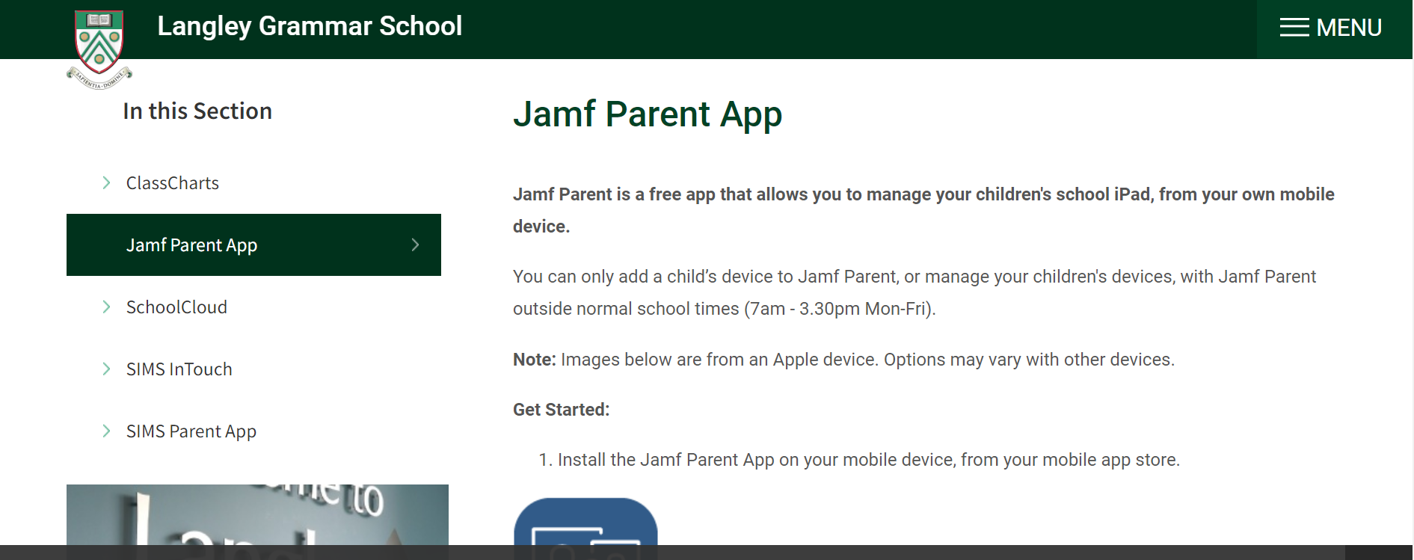
Jamf app

Slide 16
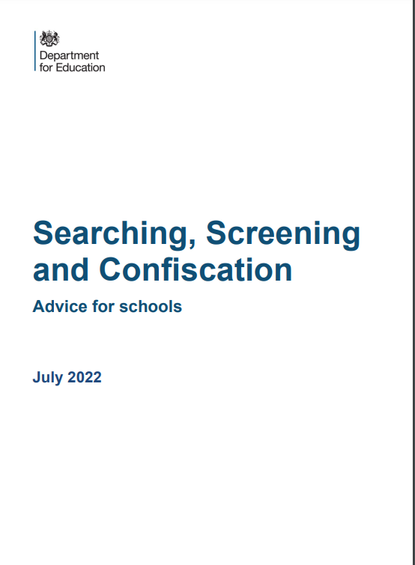
Searching and confiscating devices
Electronic devices, including mobile phones, can contain files or data which relate to an offence, or which may cause harm to another person.
This includes, but is not limited to, indecent images of children, pornography, abusive messages, images or videos, or evidence relating to suspected criminal behaviour.
Staff may examine any data or files on an electronic device they have confiscated as a result of a search, as defined in paragraph 57, if there is good reason to do so.

Slide 17

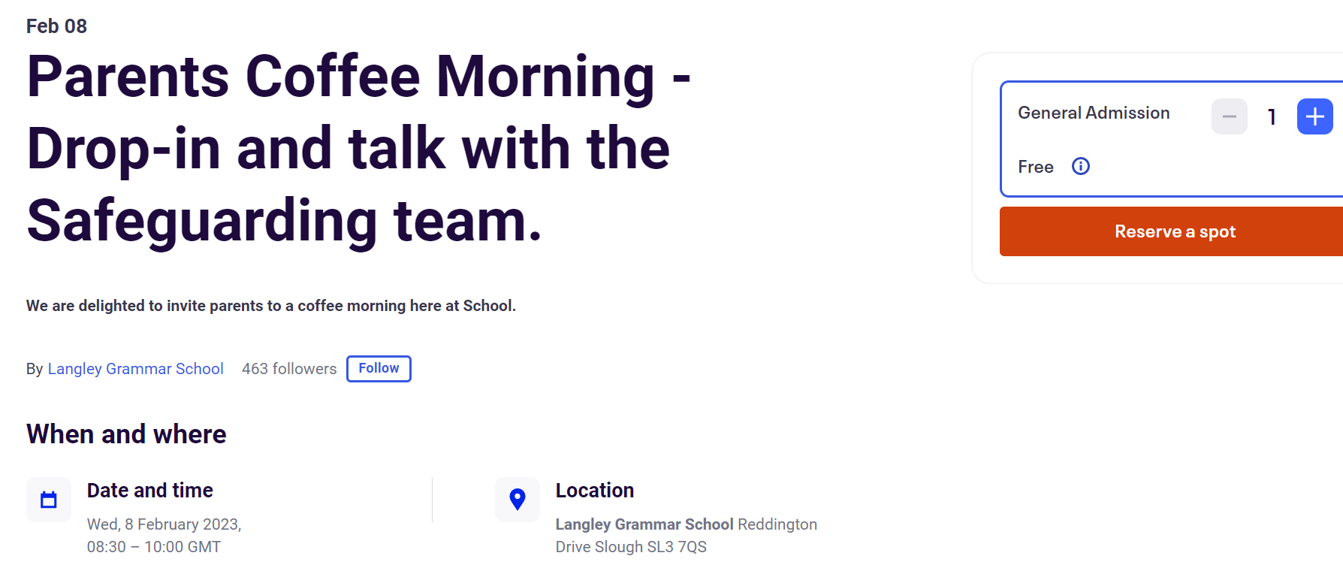
Coffee morning

Slide 18

Signposting
You will find some good tips, advice, guides and resources to help keep your child safe online on these links below:
Parents and Carers - UK Safer Internet Centre | Keeping children safe online | NSPCC | Parents Protect - Internet Safety
The NSPCC offer parental internet safety workshops, go here: https://www.nspcc.org.uk/keeping-children-safe/online-safety/free-online-safety-group-workshops/
There is also a NSPCC video to a pre-recorded webinar aimed at parents which you can circulate to your parents: Keeping Children Safe on Gaming Platforms | Webinar for parents and carers | https://youtu.be/YO6Ux7qfYXk
Guides on how to start the conversation about online safety: Teaching Your Child about Internet & Online Safety | NSPCC
The NSPCC has also published the ‘Listen up, Speak up’ free 10-minute digital training. The aim is to empower every adult to know what to do if a child needs help, and where to go if you need support yourself. This can be accessed here: Listen up, Speak up | NSPCC
TALK video from the IWF with a checklist about keeping children safe online can be accessed here: TALK Checklist by Internet Watch Foundation | Home (iwf.org.uk)

