Slide 1


Life after Langley Grammar:
Post-18 options
June 2018

Slide 2

So, what are your options?
University
Sponsored Degree
Apprenticeship -
Higher or Degree
Apprenticeship?
School Leaver Scheme or
job
5. Gap year??

Slide 3


1. University or ….
2. Apprenticeship/Sponsored Degree or School Leaver Programme
All offer paid employment + opportunity to gain a qualification
Apprenticeships can be 2-5 years
Degree & Higher Apprenticeships require A Levels; Advanced Apprenticeships require A*- C grade GCSEs

Slide 4


University
PROS:
Opportunity to spend 3 or 4 years studying something in depth that fascinates you
Qualification at the end of it which will should help you get a good job
Better promotion prospects and greater earning potential
Graduates earn £100,000+ more than non-graduates over lifetime
A chance to experience some independence, move to a different part of the country (or world) and expand your horizons
CONS:
Student debt but do you understand this?
3 or 4 years when you could be earning money instead
No guarantee that you’ll land a high-paying graduate job
Could all be for nothing if you don’t get a good Degree (many employers demand a 2:1) or you do a degree in something with poor job prospects

Slide 5

Apprenticeship/Sponsored Degree
PROS:
Combine getting a qualification with real hands-on experience plus earning a wage
Qualifications gained vary from Foundation degree, HNC/HND to full undergraduate degree
Can provide a quicker route to professional status (e.g. Chartered Accountant in 5 not 6-7 years)
Training costs covered by employers plus being paid while learning = NO DEBT
Available from increasing number of employers – e.g. Jaguar Land Rover, Lloyds Bank, EY, BBC, PwC, Sky, Shroders, British Airways
CONS:
Not all career paths/industries covered by this route
Employers determine Degree or qualification
Miss out on full university experience (i.e. social side + devoting yourself to full-time academic study)
Need to decide on specific career area from the outset, however there is always flexibility, e.g. Engineering Degree can lead to career in business and finance

Slide 6
Sponsored Degree
Type 1
Student works for an employer
Study for Degree P.T.
Tuition Fees Paid
Work during uni vacations
Employed full time after graduation
Type 2
Limited Financial Support
Student attends uni in the normal way
Student completes work placements during holidays
Student may need to work for minimum period for employer after graduation

Slide 7



To find out more about non-university options:
www.careerfinder.ucas.com
https://targetcareers.co.uk/
www.notgoingtouni.co.uk
www.allaboutschoolleavers.co.uk

Slide 8
Reminder: if you completed Centigrade….
Helped you to discover:
which courses will suit you best based on your interests and abilities
which universities offer your course(s) with the right entry requirements.

Slide 9
And if you didn’t …
Higher Ideas https://chas.careersoft.co.uk/sign-in/Default.aspx use the LGS login
https://www.theuniguide.co.uk/a-level-explorer
(A Level Explorer – links A level subjects to potential
Degree Courses)

Slide 10

1. Choose your subject: based on
A Levels
Your favourite A Level subject:
  Geography
  Chemistry
Combine two (or more) familiar subjects:
  English + Drama
  Business Studies + French
Mix of familiar + new:
  Psychology + Criminology
  Biology + Ecology
  Economics and Management
Something new but related to an area of interest:
  Zoology (related to Biology & Chemistry)
  International Relations (related to Economics, History & Politics)

Slide 11

1. Choose your subject: based on a career interest
Some decisions are straightforward:
To be a Pharmacist, you need a Pharmacy degree
To be a Psychologist, you need a Psychology degree
Other decisions are less so:
To be a Solicitor or a Barrister, you do not need a Law degree
To be an Accountant, you do not need a Maths or Accounting & Finance degree
Other related careers in a similar field may also interest you:
For example, if you are considering Nursing, what about Physiotherapy, Speech & Language Therapy, Occupational Therapy, Midwifery, Radiography or Paramedical Science?

Slide 12

1. Choose your subject: based on a career interest
Q: How do you know what degree subject you need to get into a particular career? How can you find out about other related careers?
Use these websites for answers:
https://www.prospects.ac.uk/job-profiles
https://nationalcareers.service.gov.uk/explore-careers
https://targetjobs.co.uk/careers-advice/job-descriptions
https://icould.com/explore/

Slide 13

2. Choose your course: e.g. Psychology?
Single honours BSc or BA Psychology
Specialism – e.g. Forensic Psychology
3 year BSc/BA (Bachelors) or 4 year MSc/MA (Masters)
Preliminary or Foundation year (Year 0)
Year in Industry or Professional Development
Year studying abroad
Accreditation by British Psychological Society - required for future Chartered status to work as a professional Psychologist
Add another subject. E.g Criminology

Slide 14
Remember!
  APPOX. 65% OF GRADUATE VACANCIES DO NOT DEMAND A SPECIFIC DEGREE!
  BUT EMPLOYERS WANT A GOOD DEGREE (OFTEN 2.1 OR ABOVE), WORK EXPERIENCE/INTERNSHIPS, EVIDENCE OF EXTRA-CURRICULAR ACHIEVEMENTS AND SOFT SKILLS (RELATIONSHIP BUILDING, PROBLEM SOLVING, EMOTIONAL INTELLIGENCE)
So, to have a positive uni experience, study a subject you love and will enjoy!

Slide 15
University: where do you start?
Choose your subject:
  based on A Levels
  based on a career interest
Research your course before choosing!!
Look at the modules in Years 1, 2, 3 (and 4)

Slide 16






Researching universities & courses
Use UCAS course search tool at www.ucas.com or www.unifrog.org
Research university prospectuses (most 2019 versions now in library) & websites
Revisit your Centigrade report & Degree Course Descriptions
Refer to Heap’s Degree Couse Offers in library for entry requirements or visit
https://www.theuniguide.co.uk/
https://www.thecompleteuniversityguide.co.uk/

Slide 17

Shortlisting universities
Campus or city?
Big or small?
Commutable from home, within 1-2 hours or as far away as possible?
Sports facilities? Nightlife?
Accommodation?
Cost of living?
Bursaries? Reputation? Applicants per place?
Graduate destinations? https://luminate.prospects.ac.uk/what-do-graduates-do
Use the filters on www.unifrog.org

Slide 18


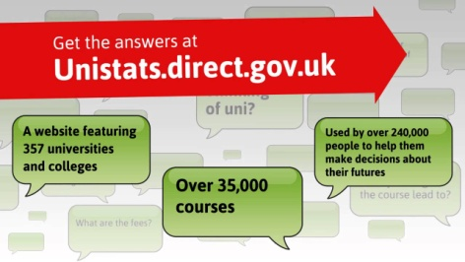

How do you decide?
Look at alternative prospectuses – e.g. push.co.uk
    Attend open days - www.opendays.com
Compare courses on unistats.direct.gov.uk
              Refer to independent league table
              www.thecompleteuniversityguide.co.uk/

Slide 19

Studying abroad
Top 5 destinations:
USA 33%
Australia 9%
France 5%
Germany 5%
Canada 4%
(2012)
www.astarfuture.co.uk – overview
www.fulbright.org.uk – USA
www.studyoptions.com – Australia/NZ
www.eunicas.ie – Europe
www.educationau-incanada.ca – Canada
Skills & knowledge:
Flexibility to see issues from different perspectives
Cultural awareness
Language skills
Confidence to deal with unforeseen challenges

Slide 20

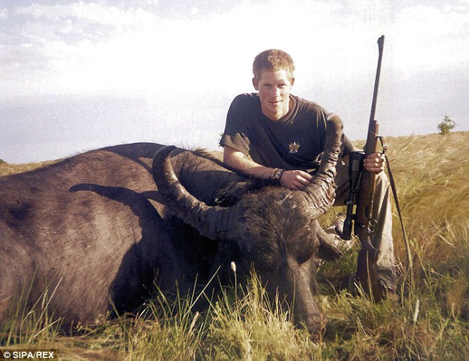
How about a gap year?
Do something worthwhile
Gap year experiences can provide evidence to impress on CVs, personal statements & job applications
Opportunity to improve grades, learn new skills (e.g. TEFL) or take a break from studying altogether
Enough time to travel as well as get a paid job and/or volunteer
http://www.independentgapadvice.org/
http://www.notgoingtouni.co.uk/
http://www.do-it.org.uk/

Slide 21

If you’re still clueless ….!
Complete a general interests questionnaire
https://www.prospects.ac.uk/job-profiles
https://nationalcareers.service.gov.uk/explore-careers
https://targetjobs.co.uk/careers-advice/job-descriptions
Attend taster courses/subject-specific events
  e.g. https://london.ac.uk/ways-study/study-campus-london/university-taster-courses
  Get more work experience
Watch video case studies
  www.icould.com

Slide 22
Support from school ….
July ‘Towards the Future’ Careers & HE Conference
          alumni talking about their university courses & apprenticeship/ school leaver schemes
          studying abroad
          gap year opportunities
July Deadline for draft Personal Statement
Oxbridge Aptitude Tests
September Predicted grades on SIMS
Early Application school deadline (Applications for Oxbridge, Medicine,
Dentistry and Vet. Science)
Mid October Competitive Application School deadlines
November and UCAS Application School deadline
Ongoing Careers support and guidance from Mr Devani, Careers Adviser
1:1 support from your tutors in terms of personal
statements (they are the gatekeepers)

