Slide 1
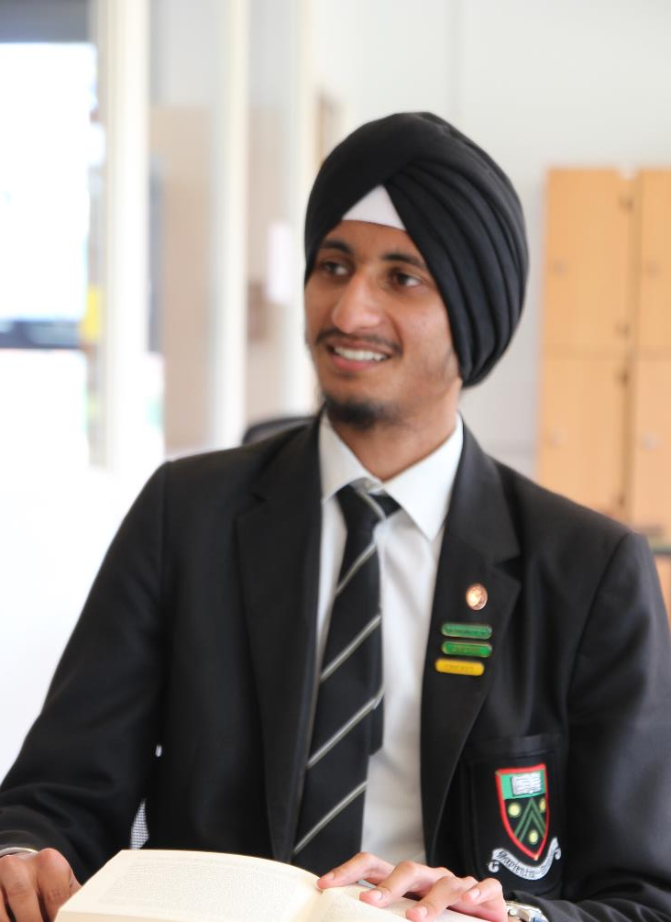
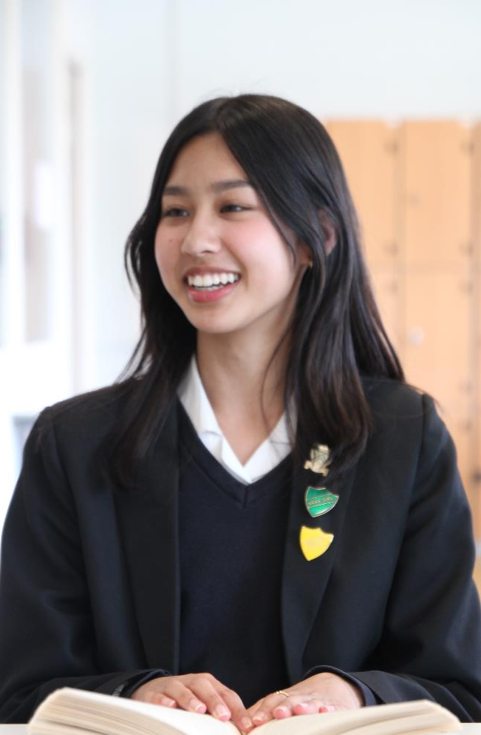
The Student Leadership Team
2024-2025
Rana Ghouse - Head Girl
Langley Grammar School places a focus on not only allowing students to reach their full academic potential, but also on personal development through captivating lessons and extracurricular activities. Here at Langley Grammar, the rapport between students and teachers is exceptionally strong, which creates a stimulating environment for students of all year groups. I am grateful to have learnt the importance of resilience, empathy and communication through my own personal journey at school, traits which will be invaluable in the future.
Simardeep Singh - Head Boy
At LGS, students are encouraged to be well rounded individuals that would strive not just academically, but in all aspects of their school life. Students are urged to join a wide range of extracurricular activities, ranging from sport to drama and to music. Our school has a wealth of diversity that enriches the educational experience for everyone. The exceptional teaching and support available to all students are pivotal in shaping us into confident young adults. Personally, being a part of and leading sports teams throughout my time here has boosted my confidence and provided valuable experience in leadership roles, preparing me for challenges beyond school.

Slide 2
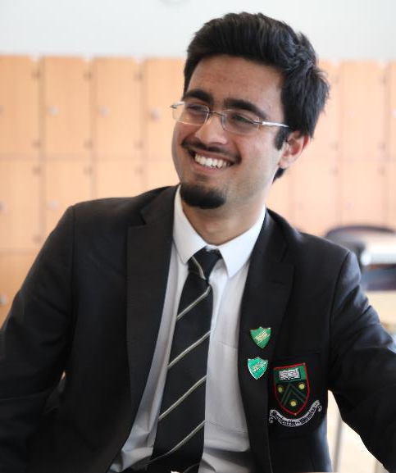
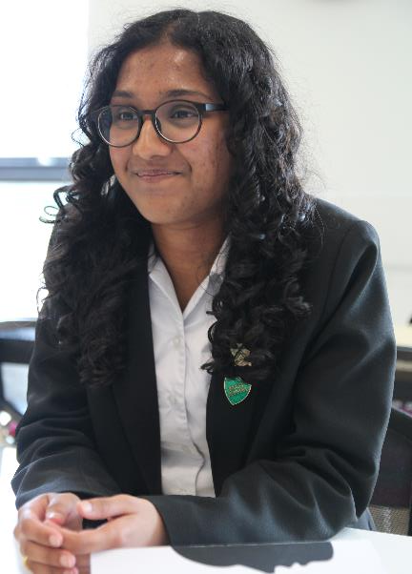
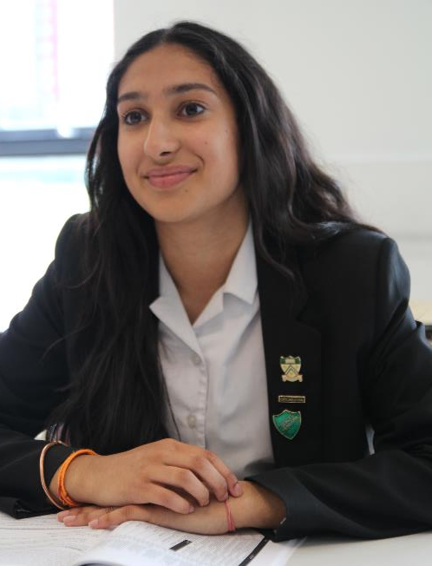
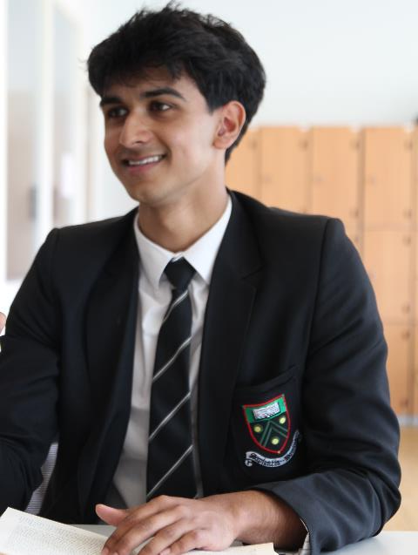
Anarghya Kukke - Deputy Head Girl
From Year 7, LGS has given me the ability to thrive academically, with the excellent support from teachers and the countless opportunities provided through various means. Throughout my time here, I have found interests in topics across many subjects within the classroom walls, yet additionally, I believe the school has shaped me as a person, with its multiple extracurricular facilities too. Being part of a few of LGS’s multiple clubs, has given me occasions to grow and become more well-rounded, which is an ethos that LGS emphasises.
Nafiz Noor - Deputy Head Boy
Langley Grammar School is filled to the brim with highly talented and hard-working students, students whose proficiency is not exclusive to just academia but rather including many other categories such as sports and the arts. Having a community with such a dense concentration of skilled people causes a synthesis of an environment where a student thriving is the norm. My time at LGS has encouraged me to chase progress in many areas of life as it has been made clear to me here that you should never limit yourself to a single field.
Haider Hussain - Deputy Head Boy
From Year 7, students at Langley Grammar School are encouraged to achieve excellence. Naturally, this comes in the form of academic vigour but also in the form of extracurricular activities such as sport, music, and drama. This means students leave school not only with a fascination of their subjects, but also with superb interpersonal skills that are carried forward into university and the workplace. This, accompanied by world class teaching and facilities makes LGS an outstanding place to receive an education.
Asveni Kalatharan -Deputy Head Girl
Having been at the school for six years now, I can say with confidence that it has been a motivating and inspiring community to be a part of, where we are provided with endless opportunities to discover who we are as individuals. We are lucky enough to have exceptional teachers, who ensure we learn in the best way possible, which is what makes Langley Grammar so unique. My drive to work to the best of my ability has been a product of this stimulating environment, which I will continue to foster in the future.

Slide 3
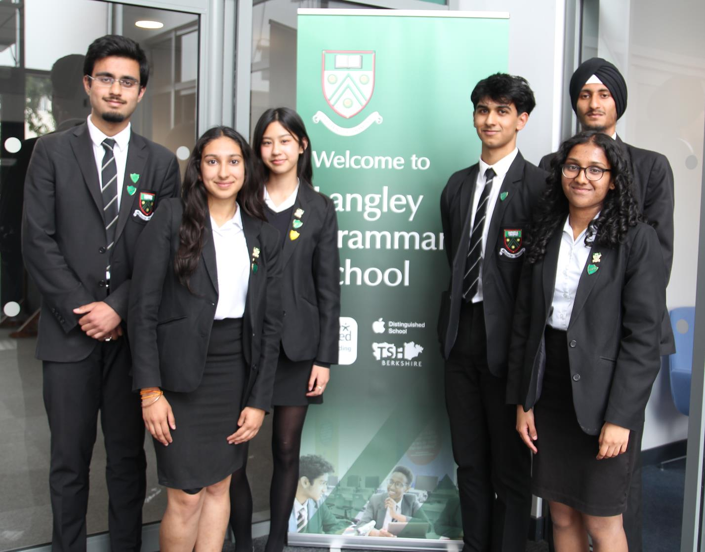

Slide 4
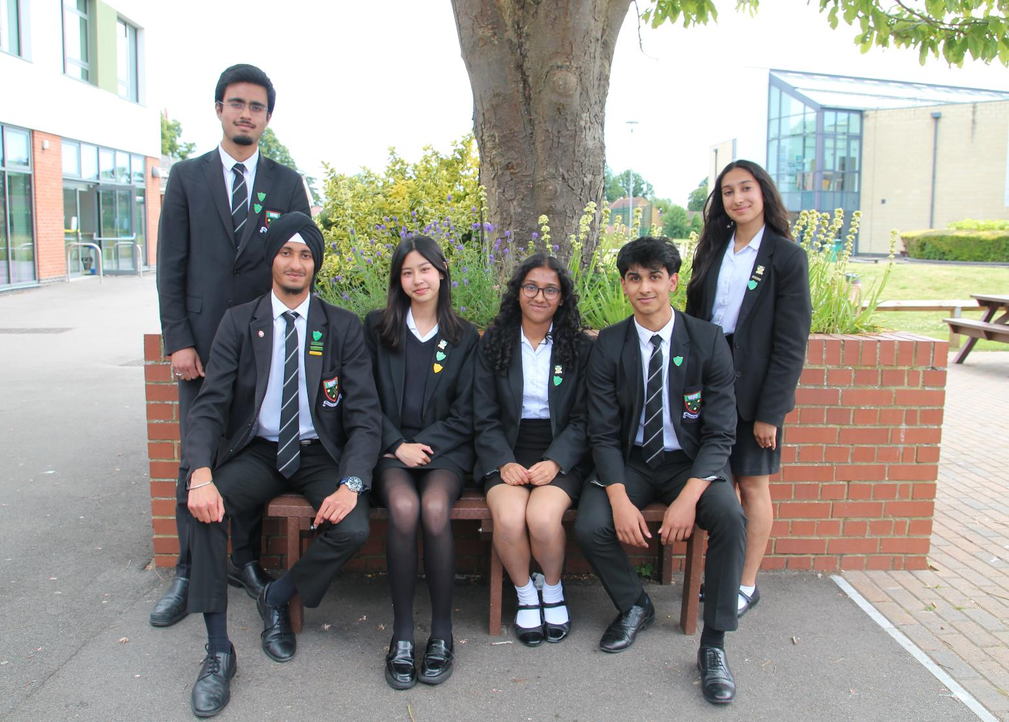

Slide 5
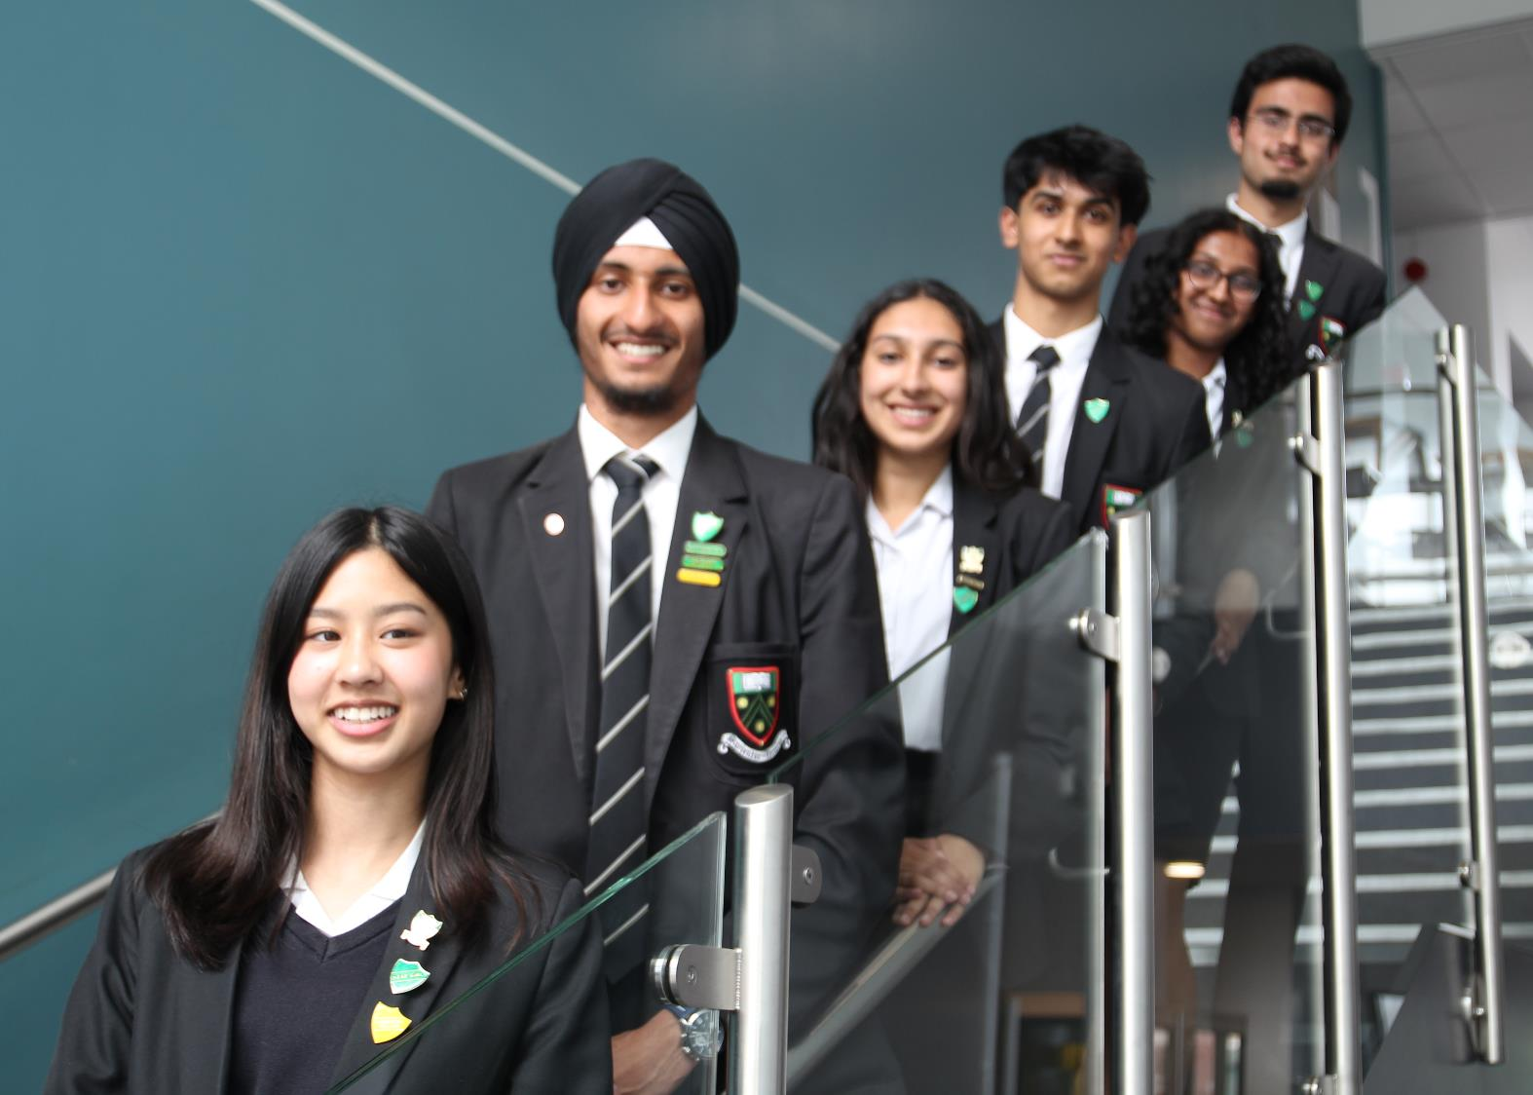

Slide 6


